Slide 1
CSC4303 (Spring 2026)
Getting Started with AWS EC2
TA: Ye Wang

Slide 2
About me
Ye Wang, Ph.D. yr2 student, SDS
Supervisor: Prof. Minchen Yu
Email: yewang2@link.cuhk.edu.cn
Office: Zhixin 431
Research Interests
I’m broadly interested in AIsys, distributed ML and serverless AI ...

Slide 3
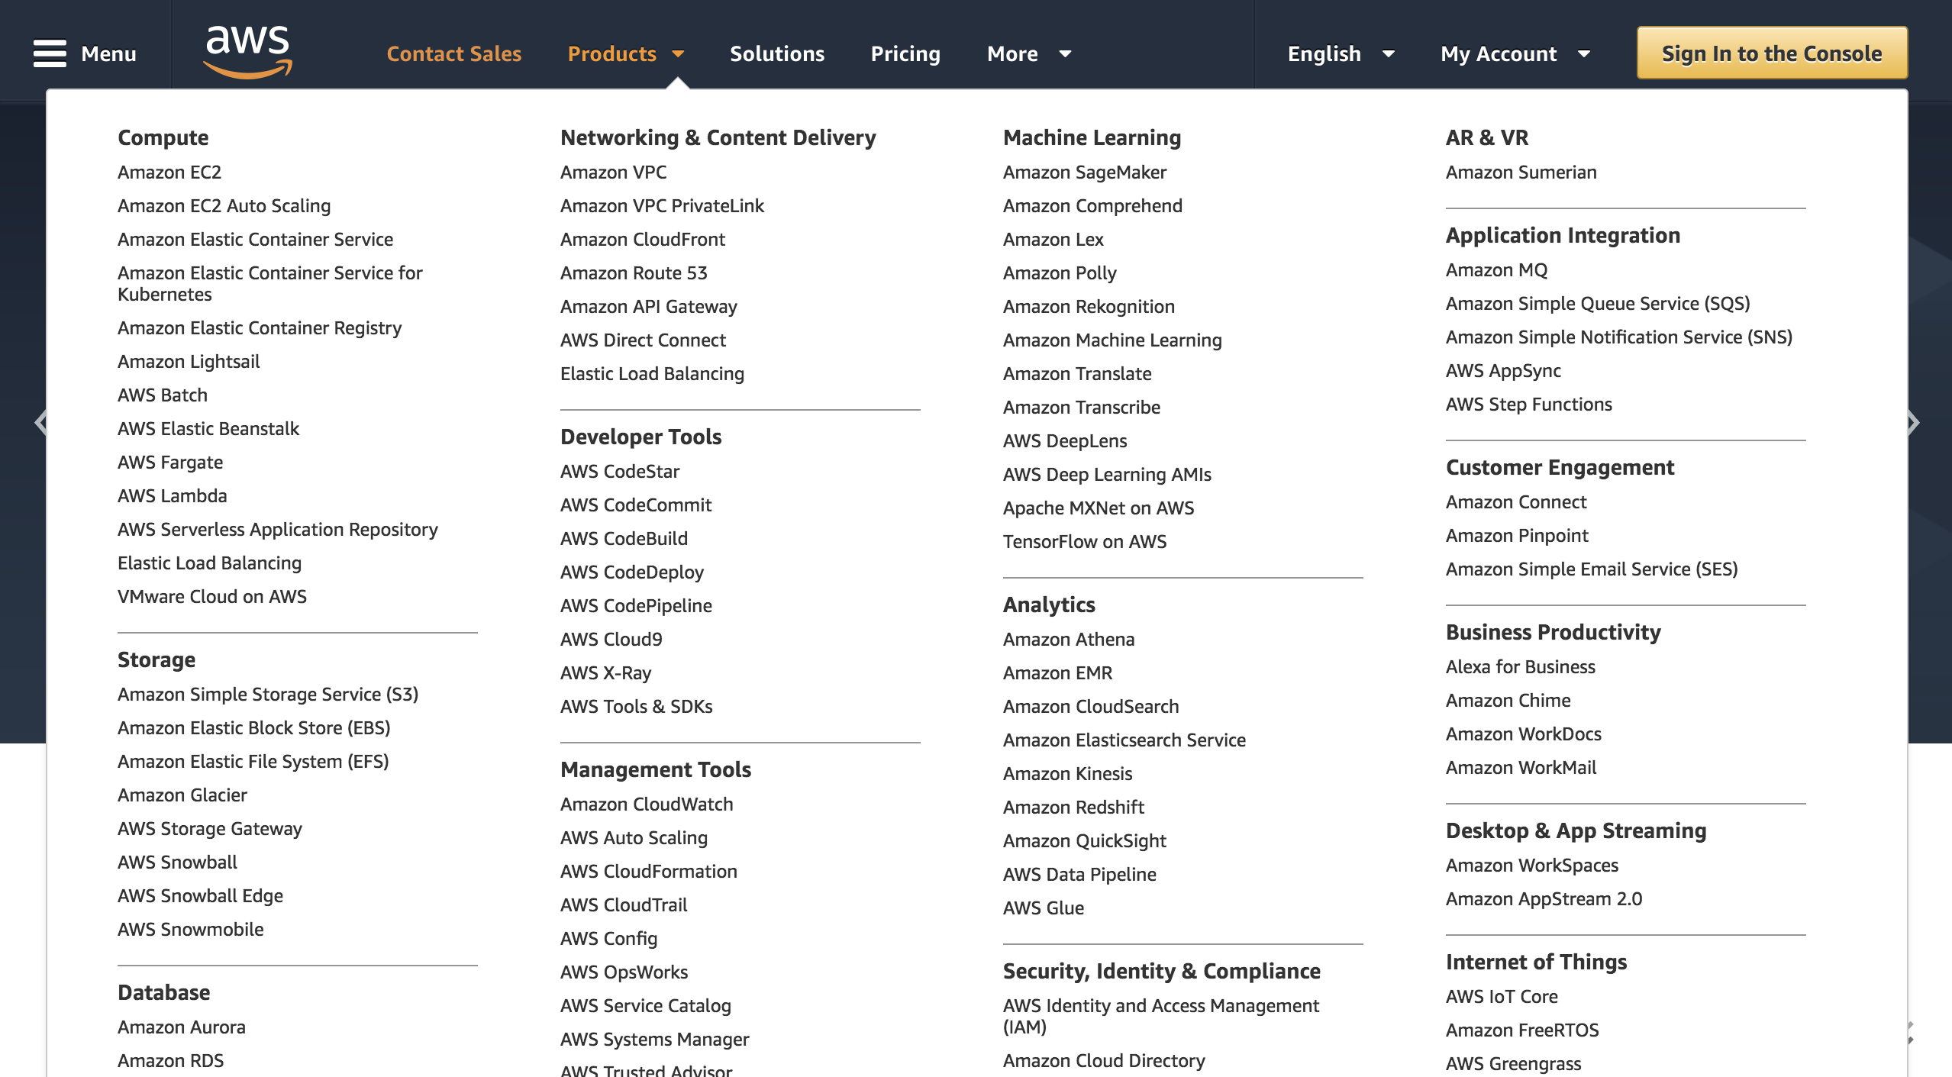
Amazon Web Services (AWS)
Notes:
Creating AWS account: http://www.youtube.com/watch?v=WviHsoz8yHk
Getting started with Amazon EC2-launch a windows instance: http://www.youtube.com/watch?v=OLfmqcYnhUM

Slide 4

What is EC2?
Amazon EC2
“Amazon Elastic Compute Cloud (Amazon EC2) is a web service that enables you to launch and manage Linux/Unix and windows server instances in Amazon's data centers.”
EC2 is part of Amazon’s “pay per use” web services for software development

Slide 5
Outline
Create an AWS Account
Launch an EC2 Instance
Connect to an EC2 Instance
Stop an EC2 Instance

Slide 6
I am Going to Introduce 2 Ways
Way 1: Get started with a Classroom Account
Every student gets $50 USD credits in this course
Activate educate account via invitation link from the instructor
Way 2: Get started with a normal account
If some services are not supported by AWS Educate Program
If the $50 USD credits have been run out of
...

Slide 7
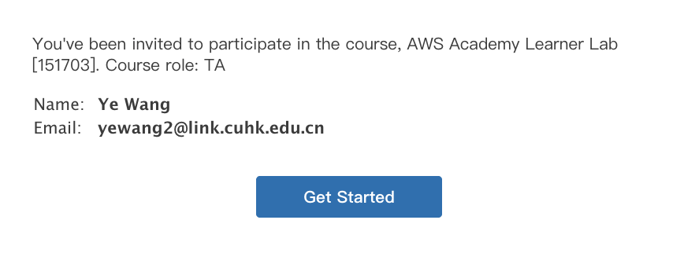
Get Started with a Classroom Account in Amazon Educate
After receiving this email, just click on the link
The AWS Academy Learner Lab for this class is [151703].

Slide 8
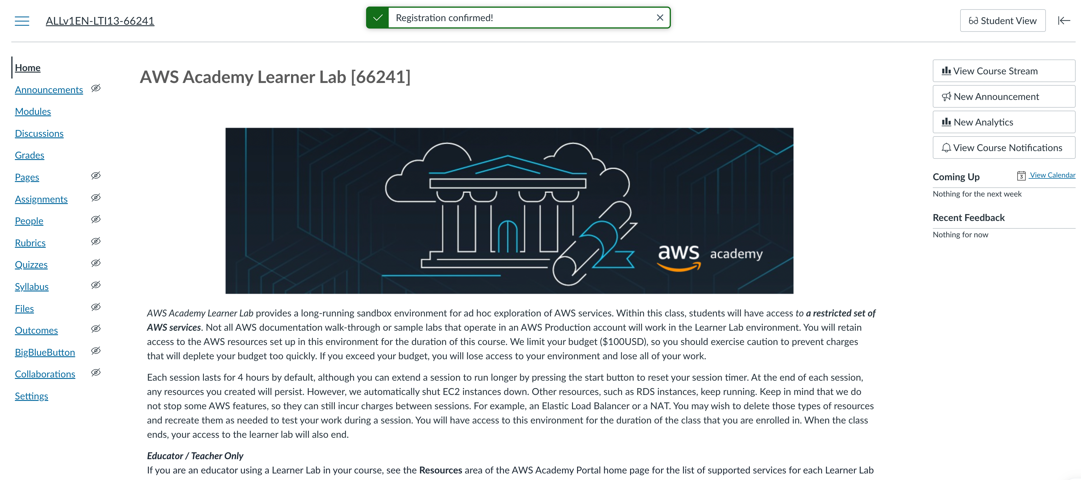
You are supposed to see AWS Academy homepage

Slide 9
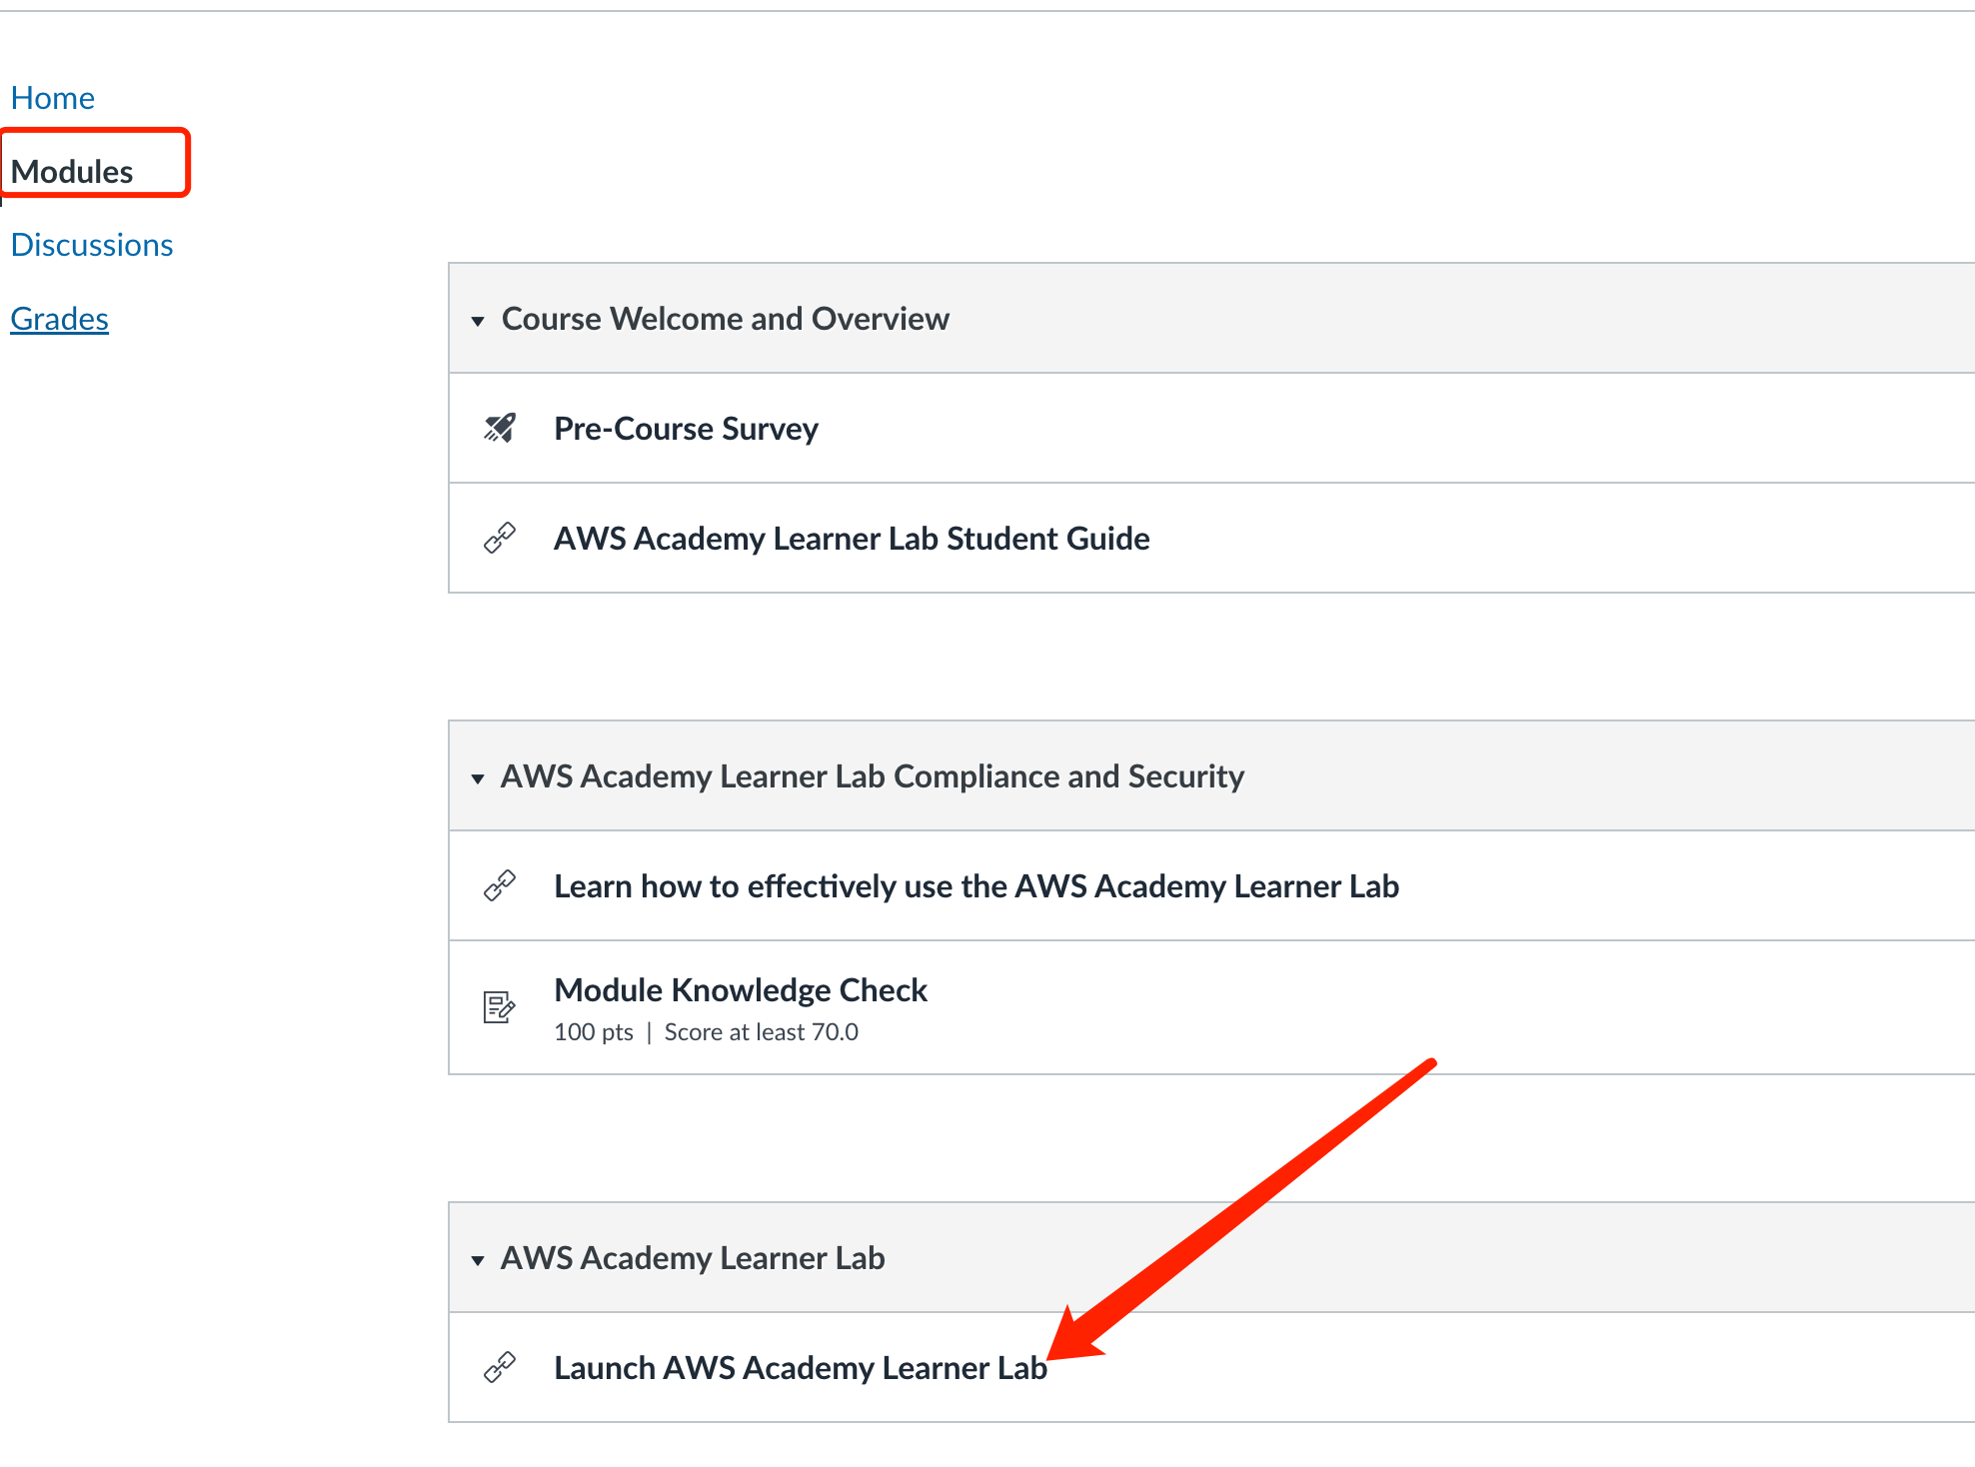

Slide 10
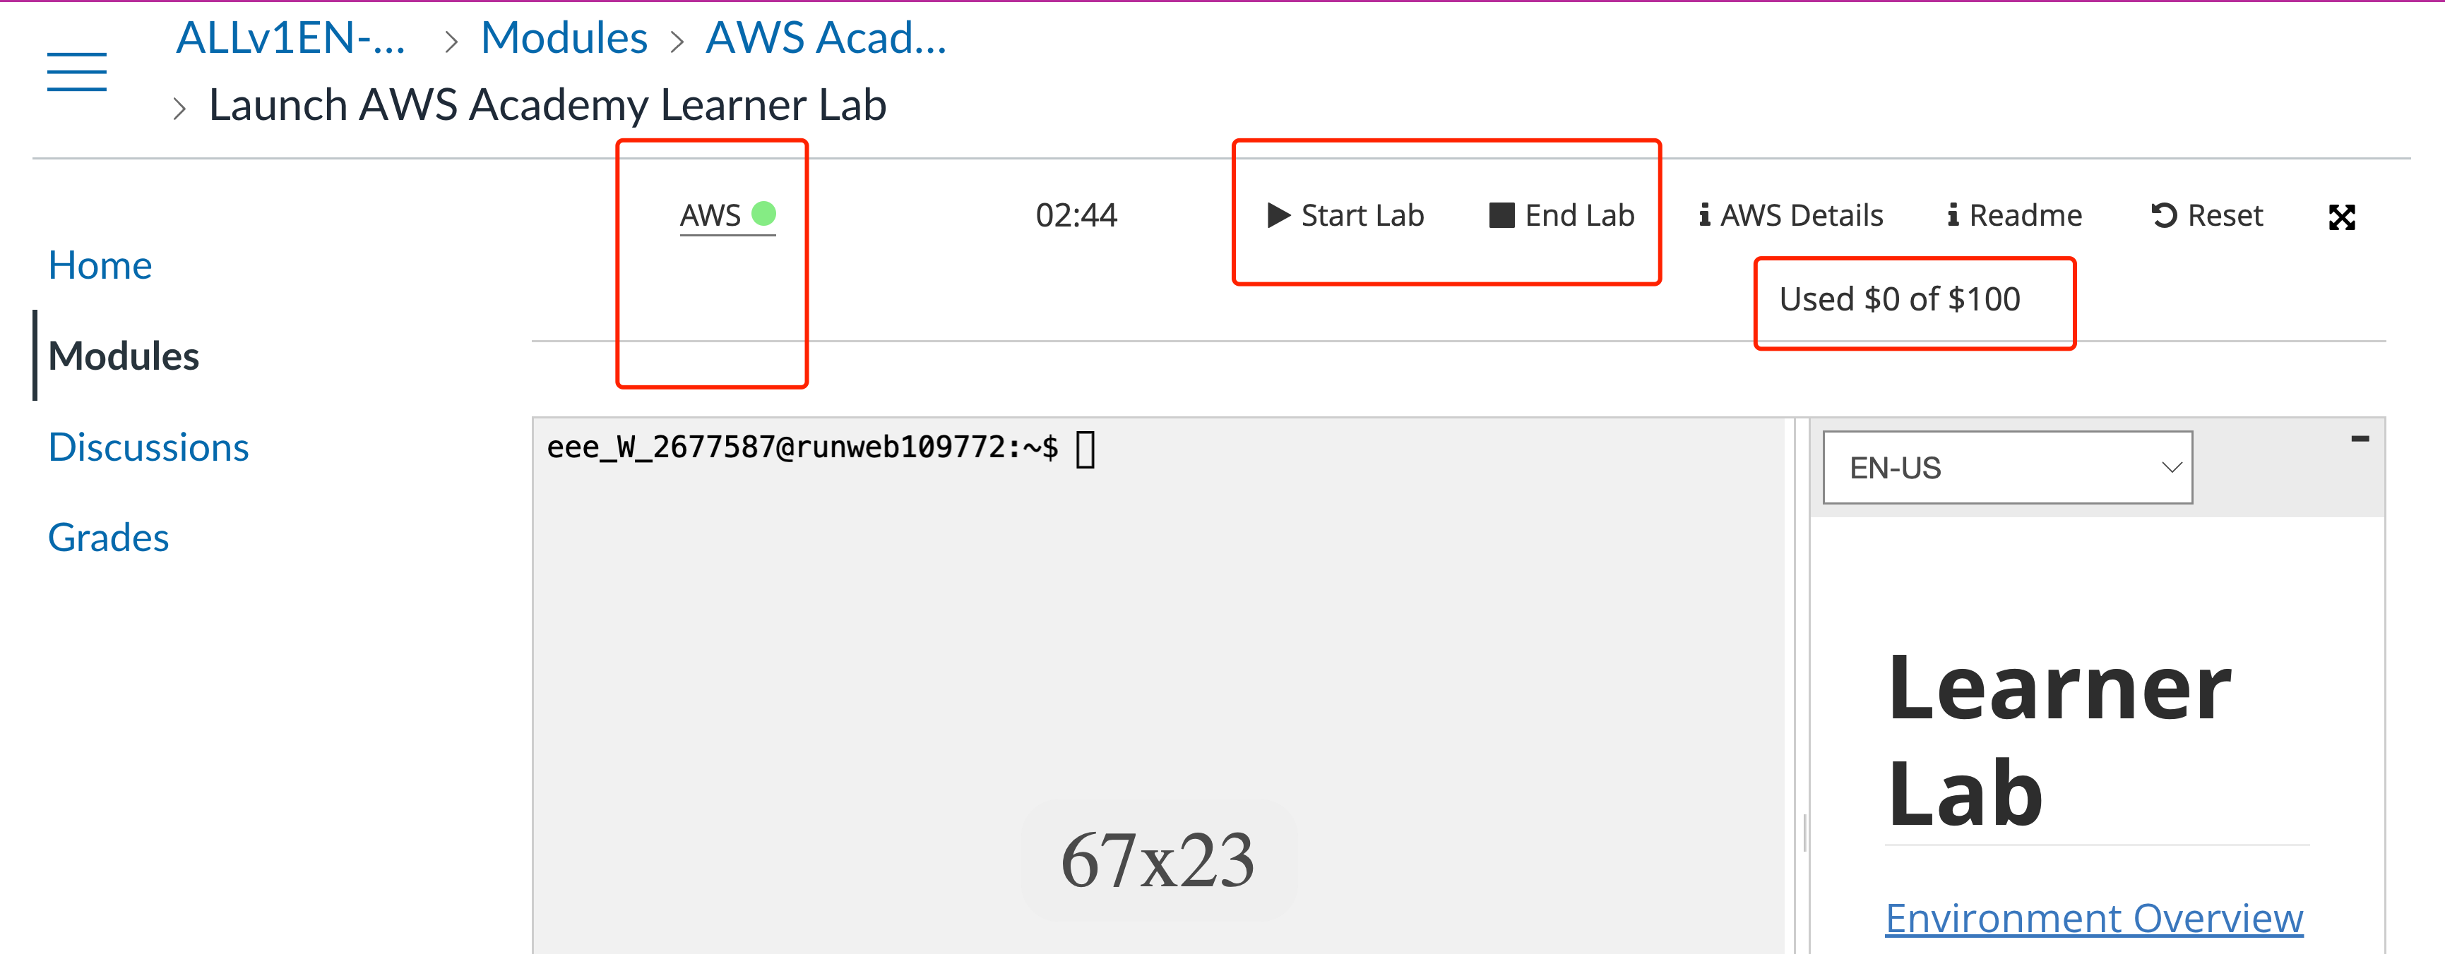
Under Module – Launch learner lab, you can start the lab sandbox for AWS services.
”green” means the lab is on; “red” means the lab is off. Once the lab is on, click “AWS” then is directs you to AWS home console.

Slide 11
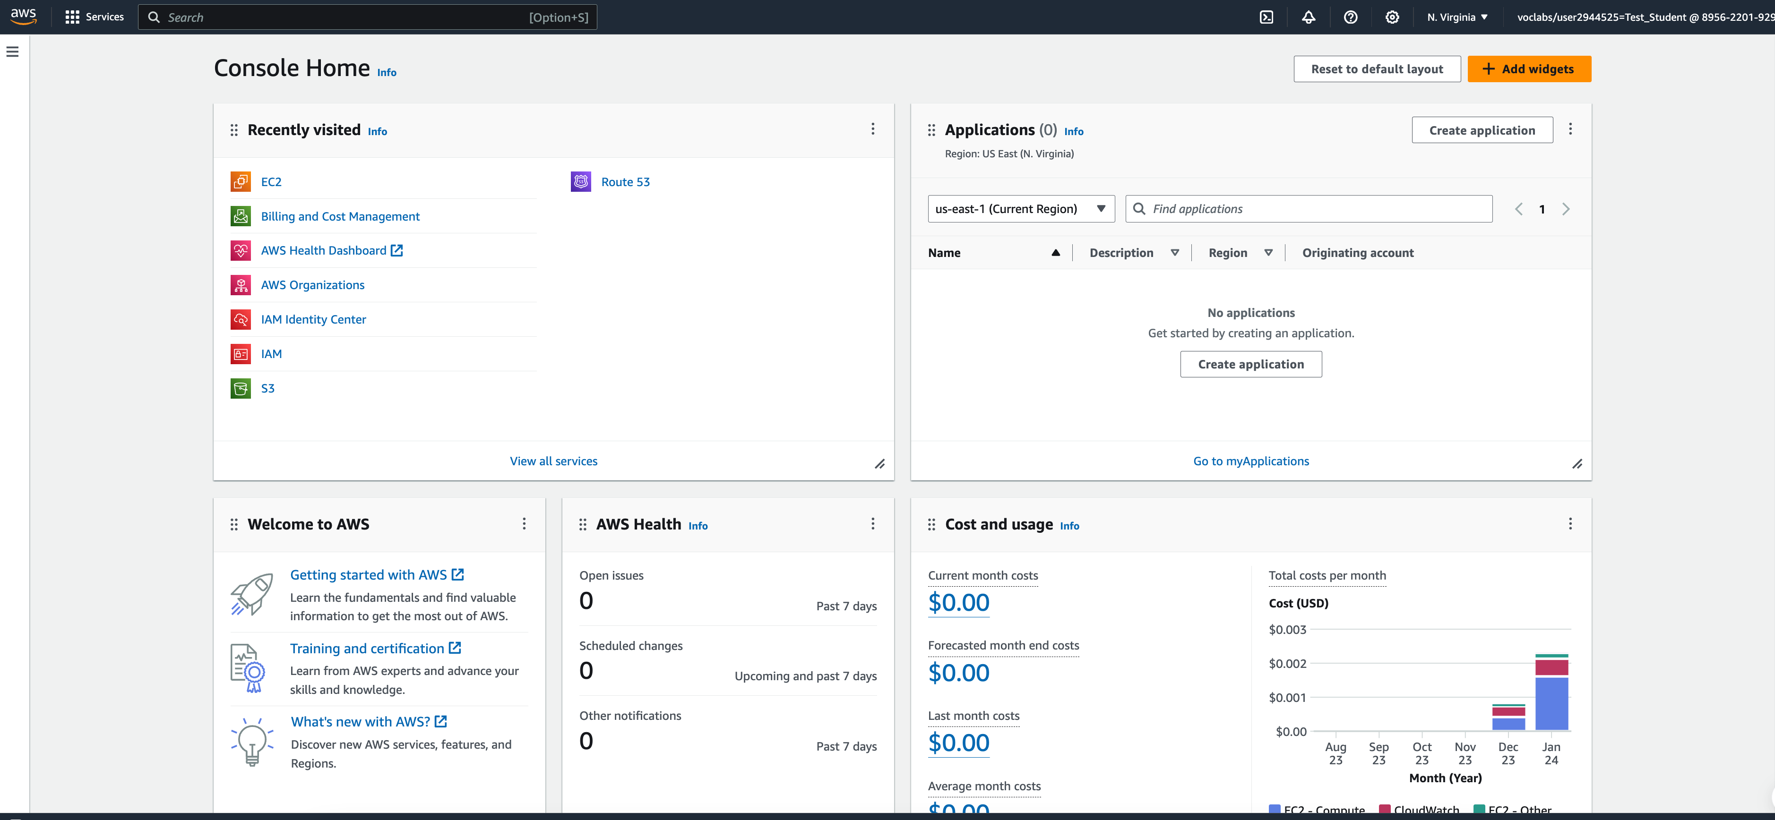
e.g., EC2 is the service that we will talk about later

Slide 12
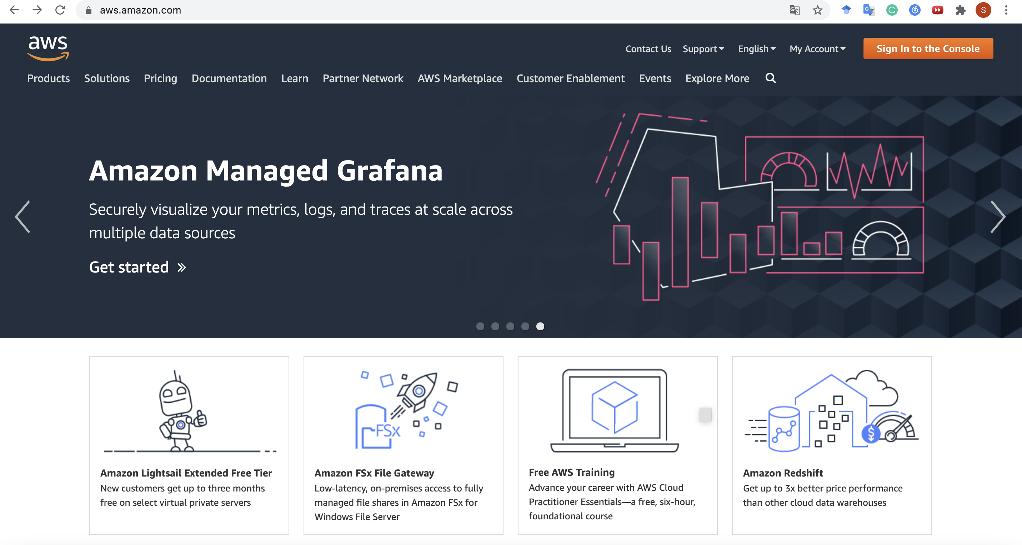
Way 2: Get Started with a Normal AWS Account
Click here

Slide 13
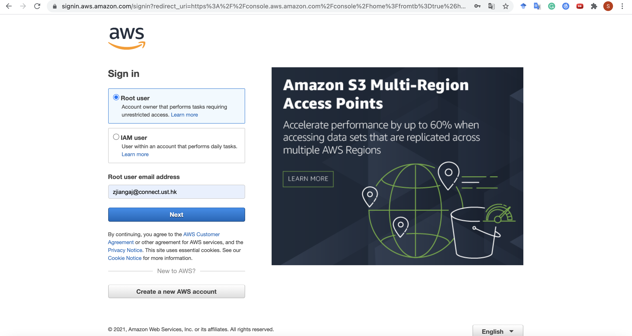
Get Started with a Normal AWS Account
Then here

Slide 14
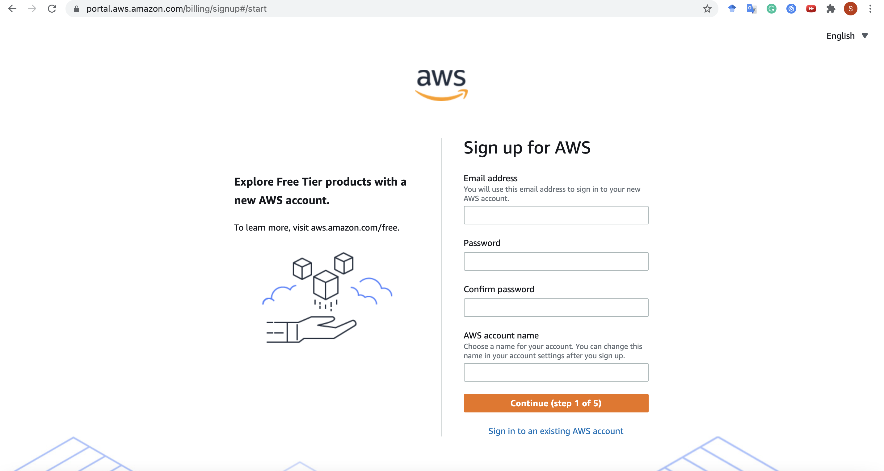
Get Started with a Normal AWS Account
Enter your credentials

Slide 15
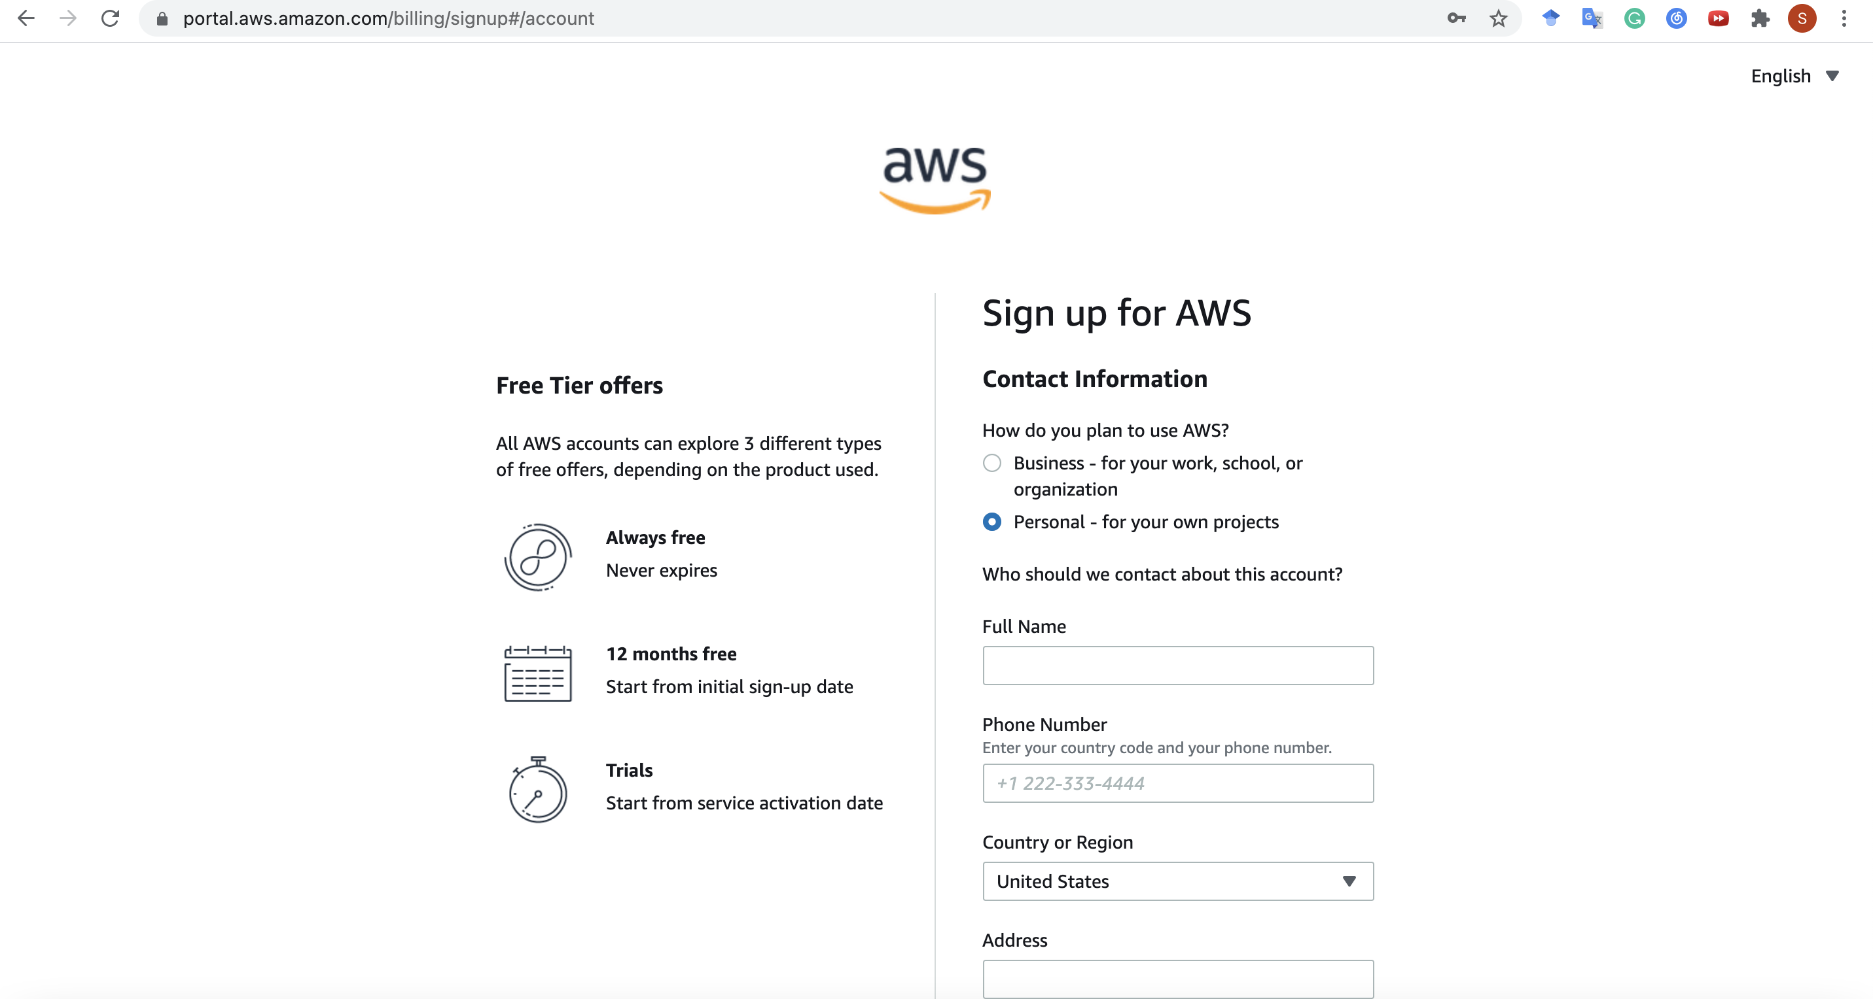
Get Started with a Normal AWS Account
Choose “Personal” and
enter your information…

Slide 16
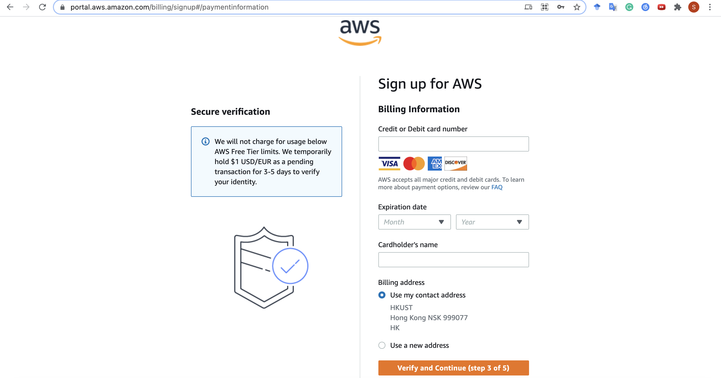
Get Started with a Normal AWS Account
and card information…

Slide 17
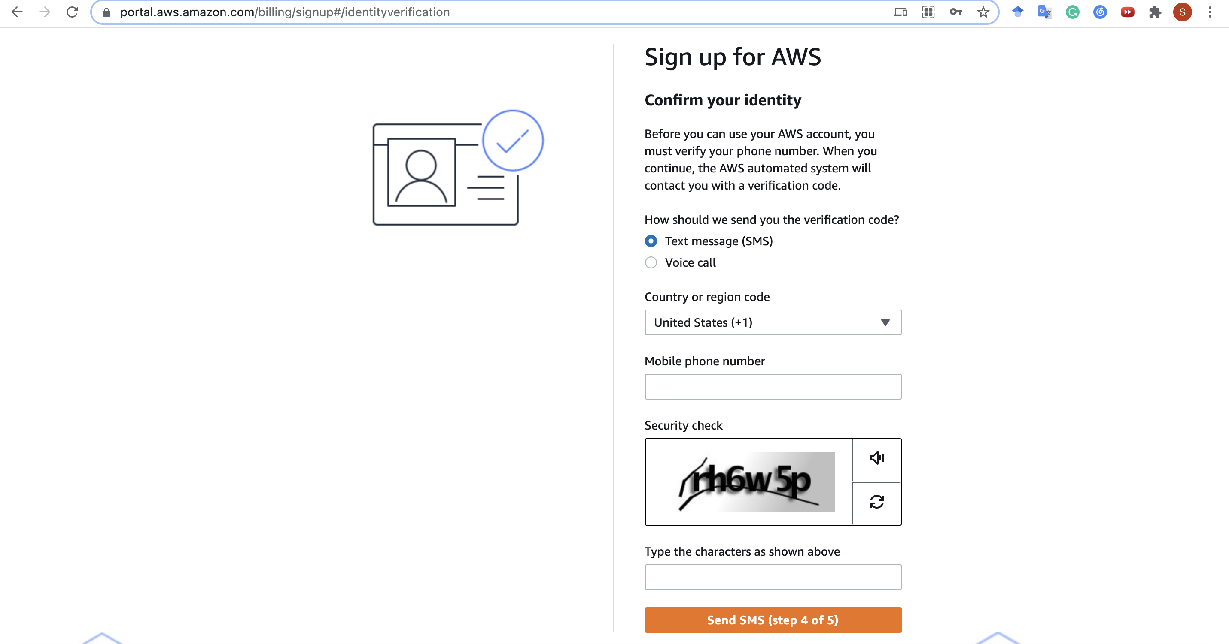
Get Started with a Normal AWS Account
and phone number

Slide 18
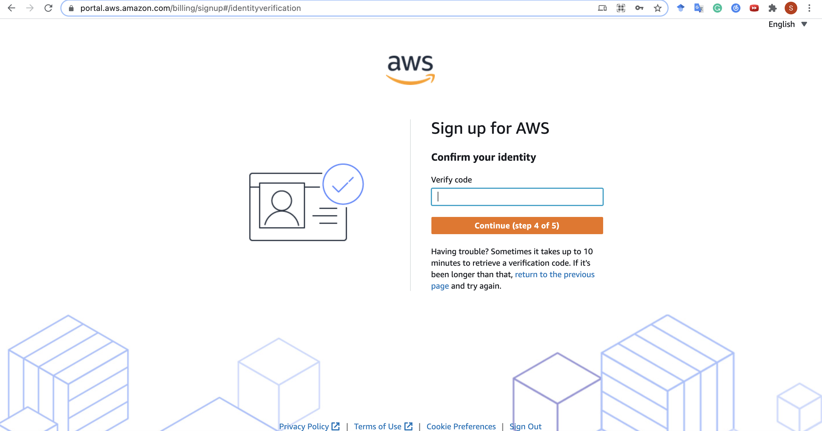
Get Started with a Normal AWS Account
Enter the verify code you receive via SMS
p.s. Authentication via Voice call is also OK

Slide 19
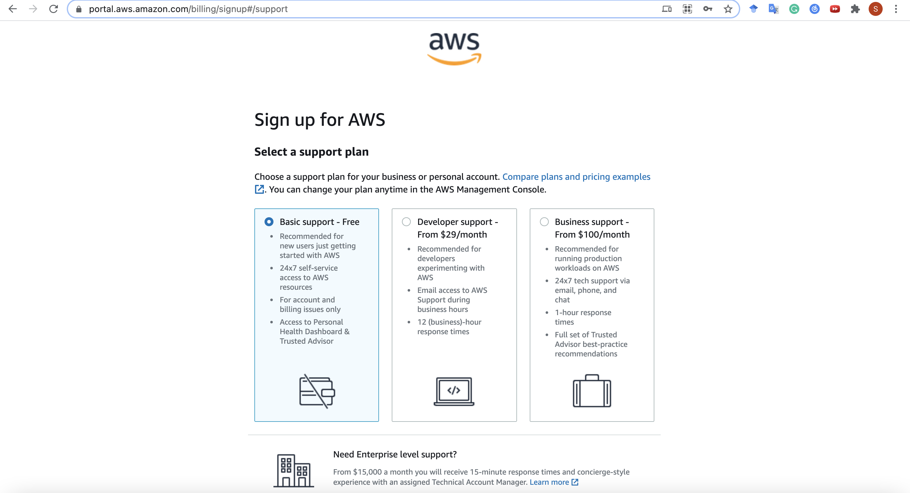
Get Started with a Normal AWS Account
Select “Basic Plan”
and complete!

Slide 20
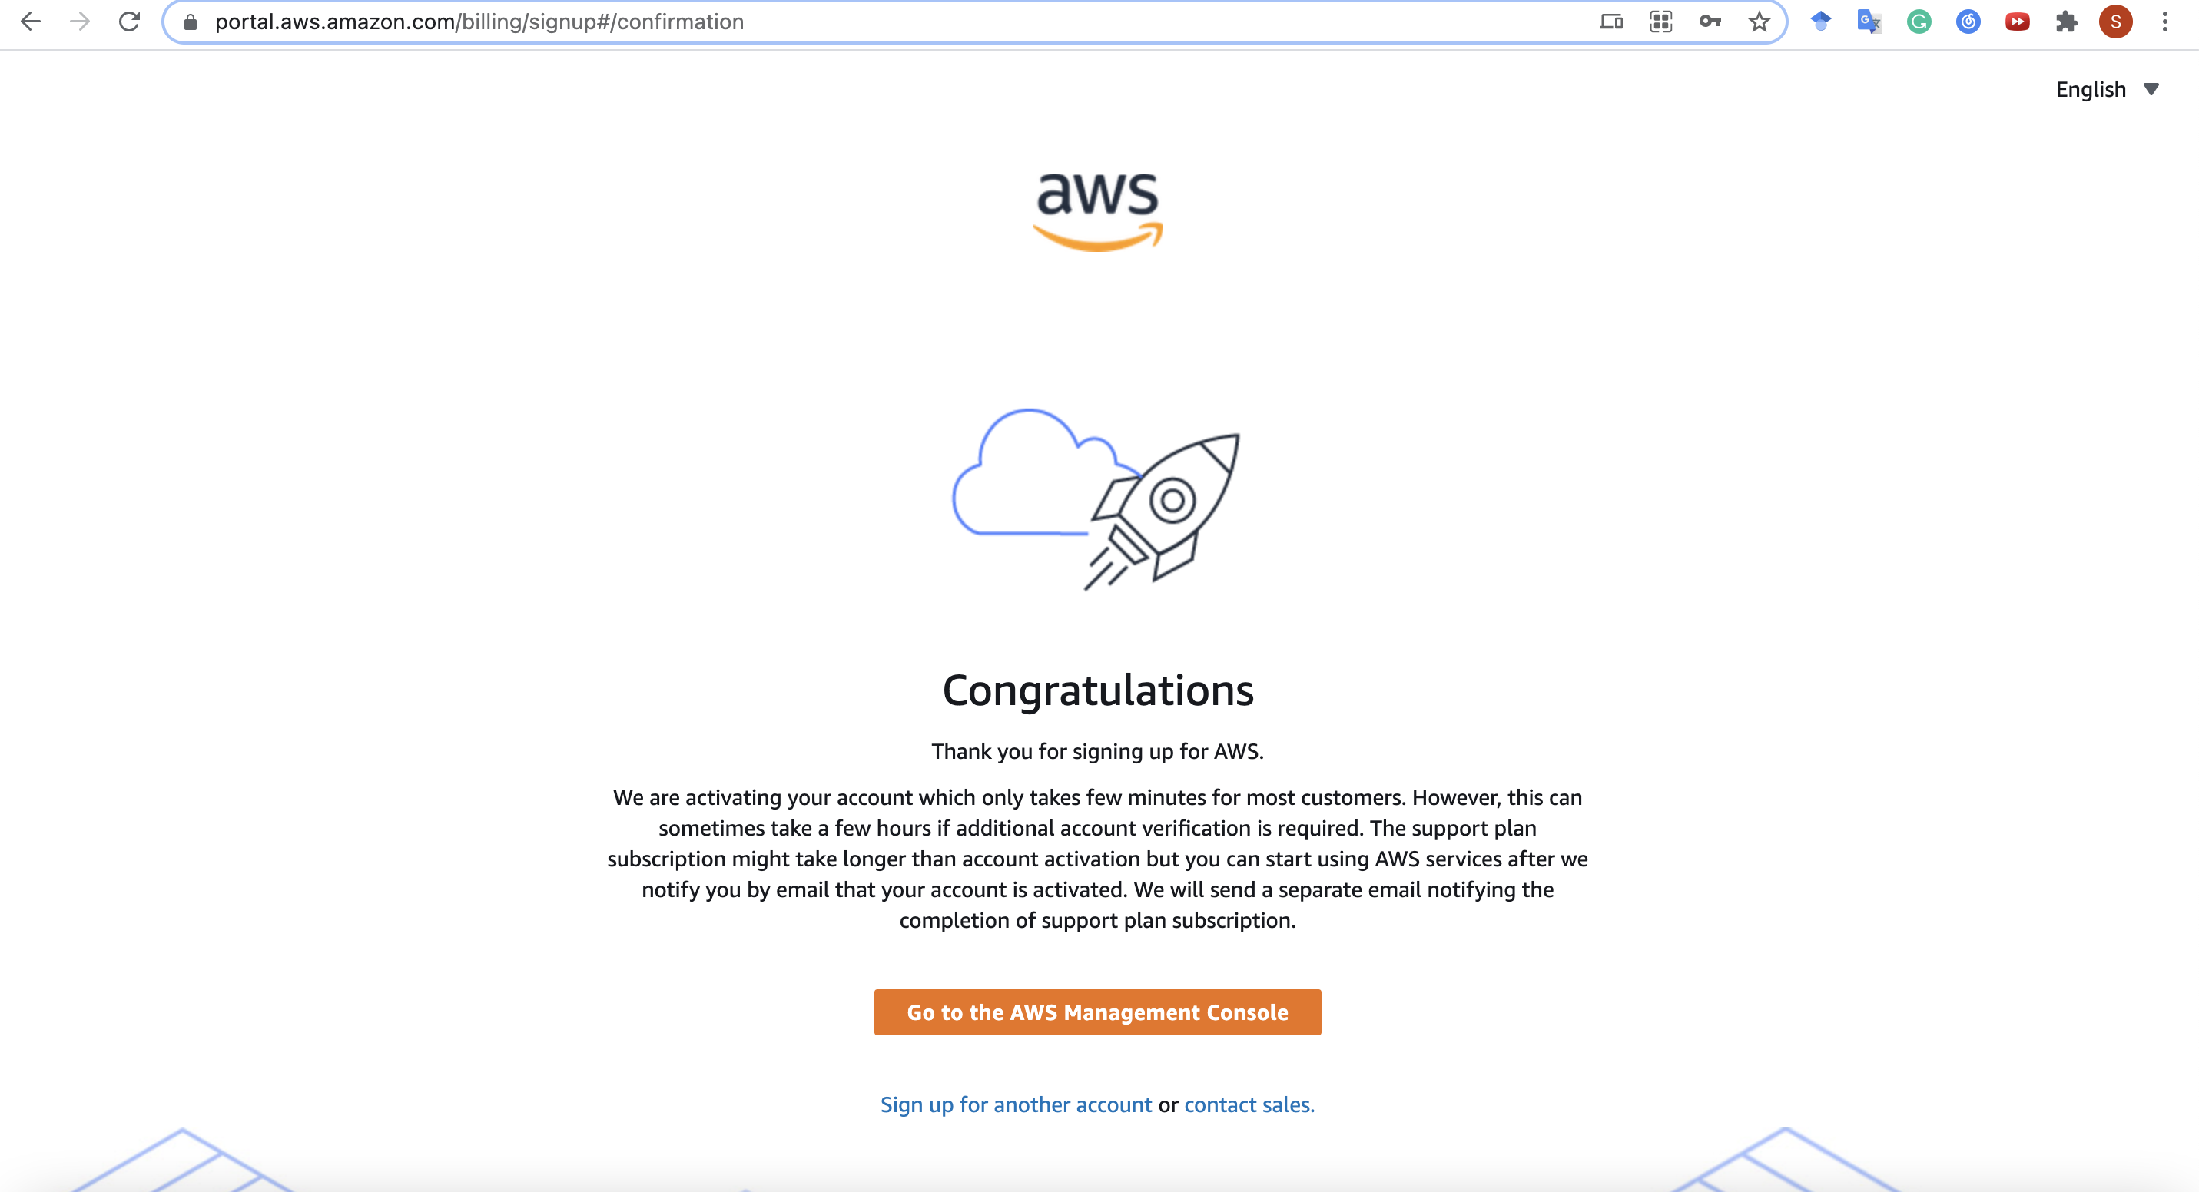
Get Started with a Normal AWS Account
Cool! Try to sign in here

Slide 21
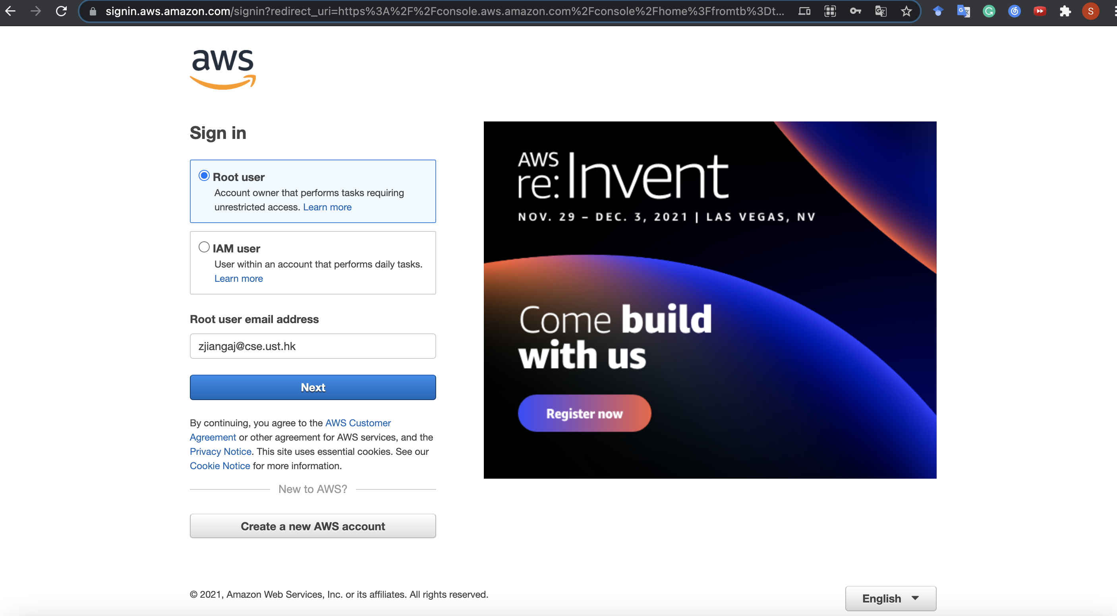
Get Started with a Normal AWS Account
Select root user

Slide 22
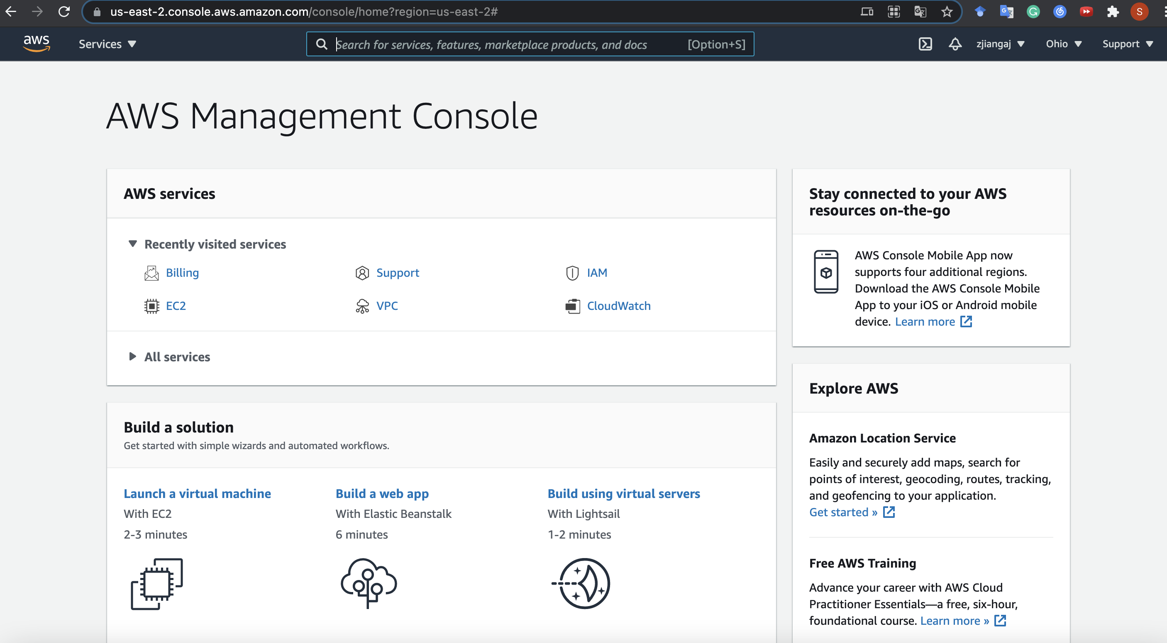
Get Started with a Normal AWS Account
Finish! You may explore the console now...
For example, you can see your service fee or change your payment method here
EC2 is the service that we will talk about later

Slide 23
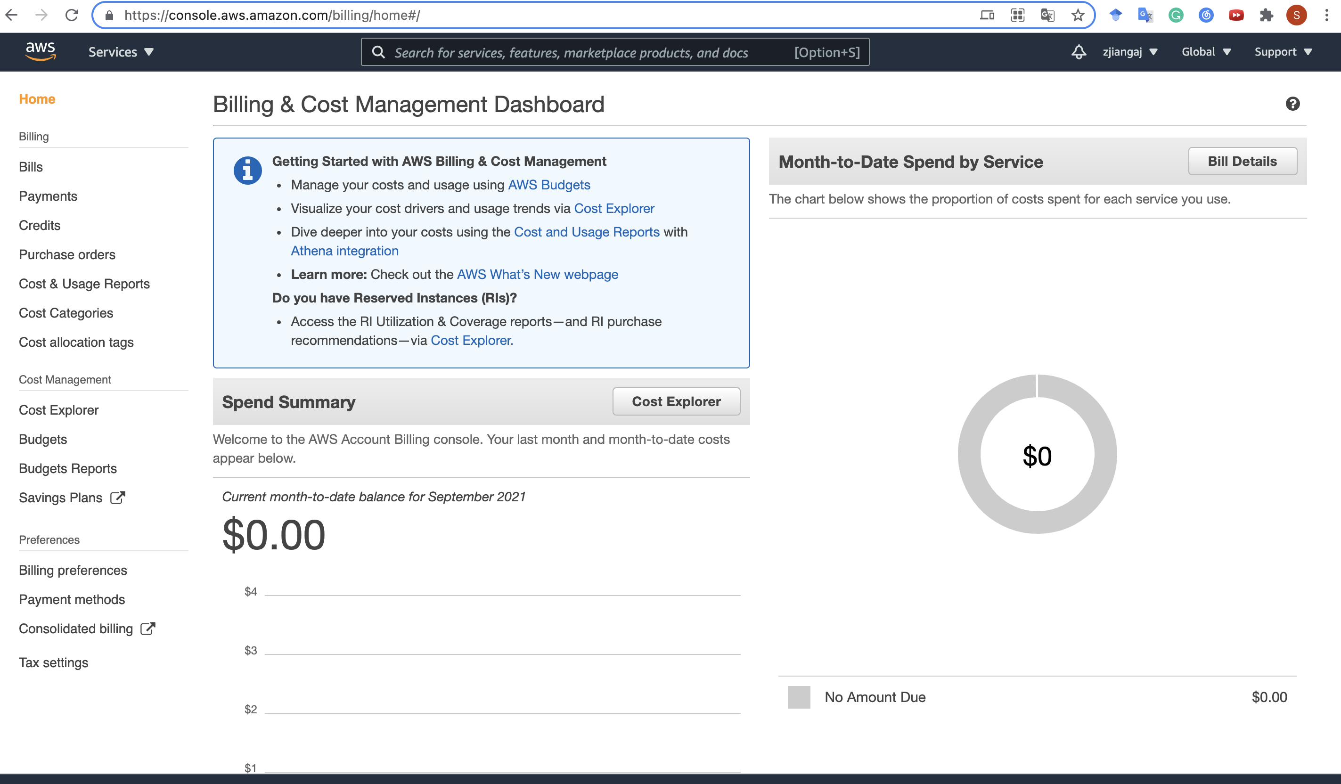
Get Started with a Normal AWS Account
A brief overview on the Billing Console...

Slide 24
Outline
Create an AWS Account
Launch an EC2 Instance
Connect to EC2 Instance
Stop an Instance

Slide 25
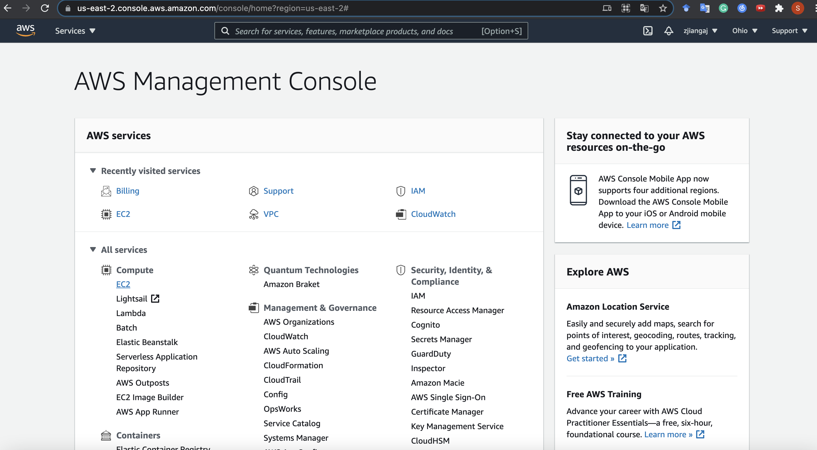
Surf the EC2 Console
Click here to enter
EC2 management console

Slide 26
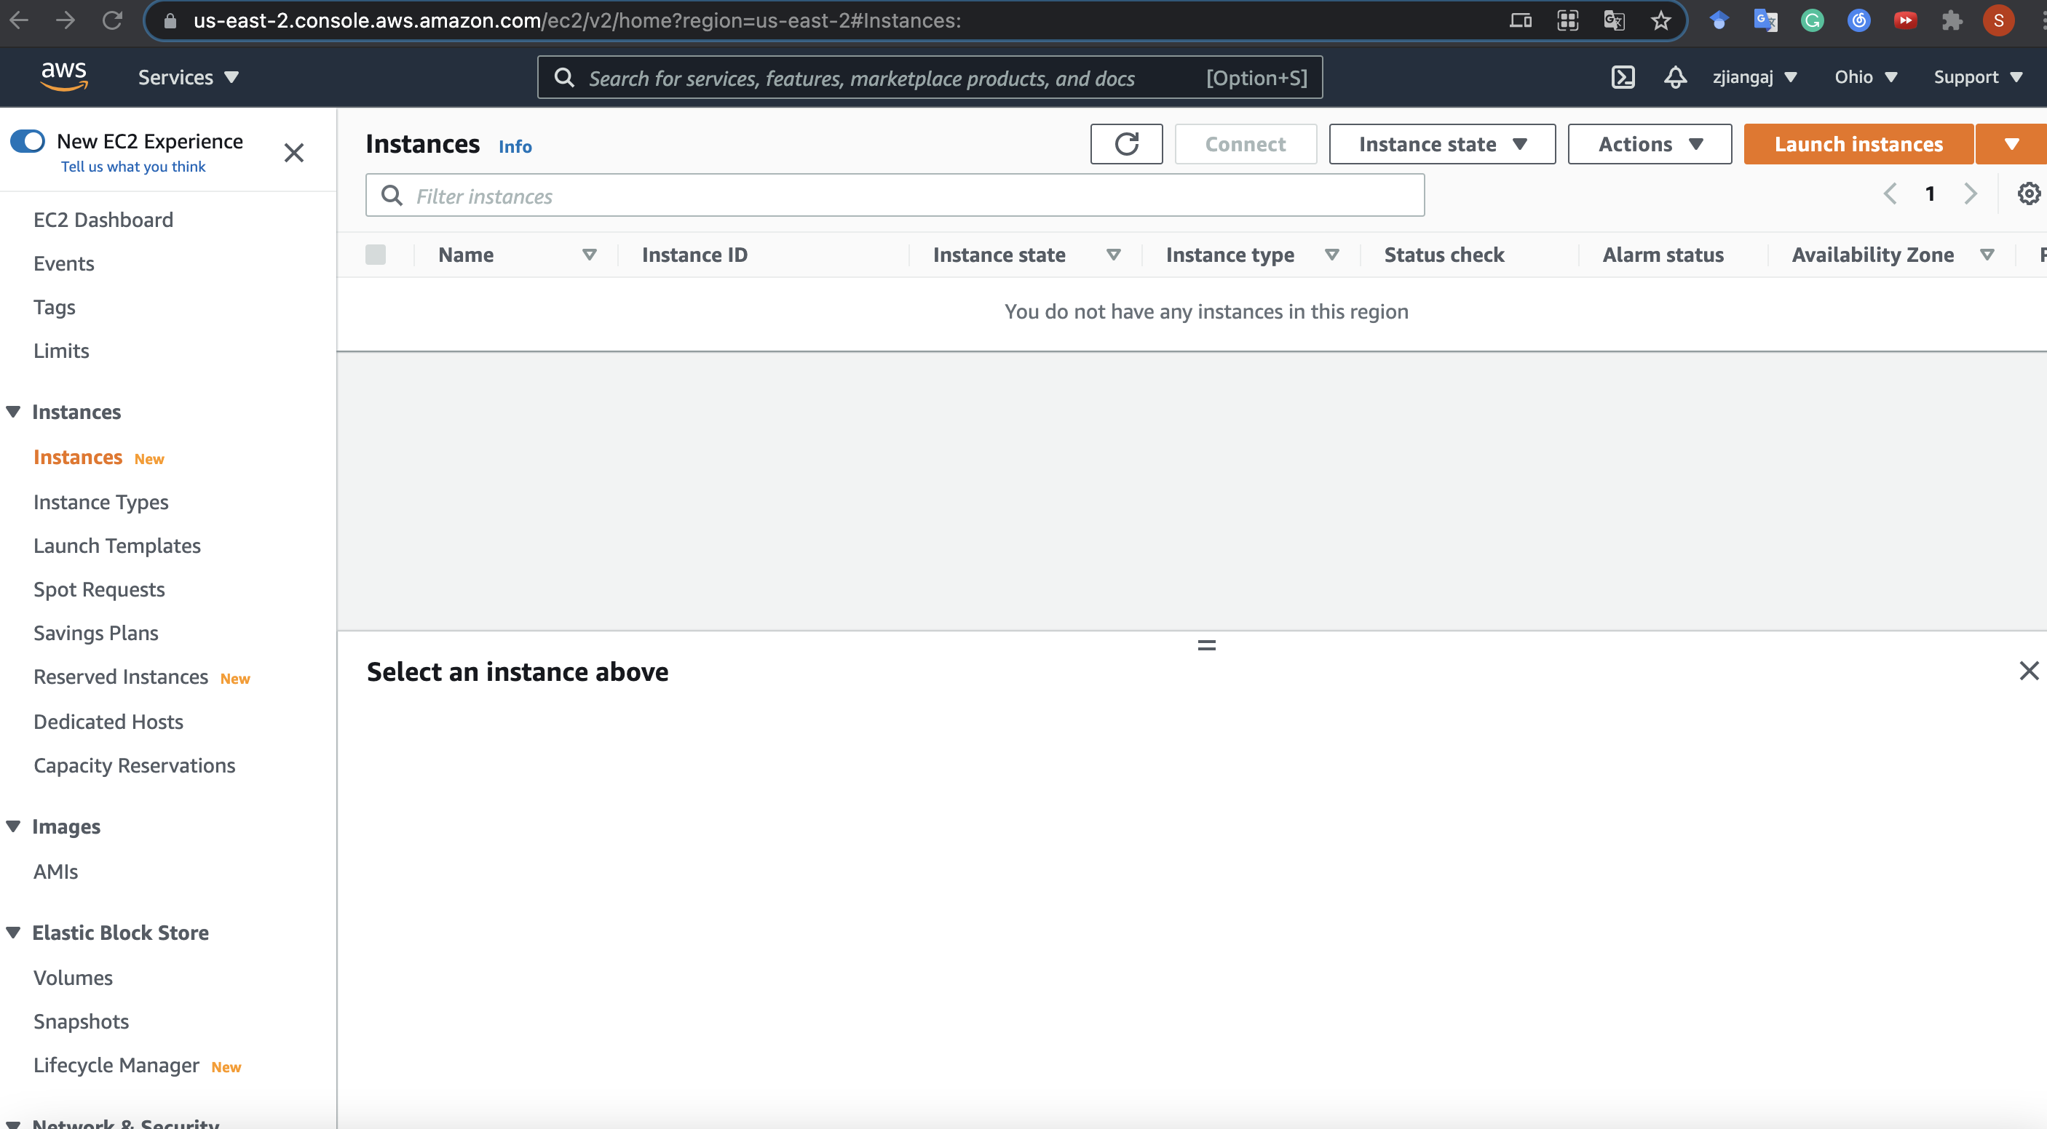
Surf the EC2 Console
On success you will see the Instances panel

Slide 27
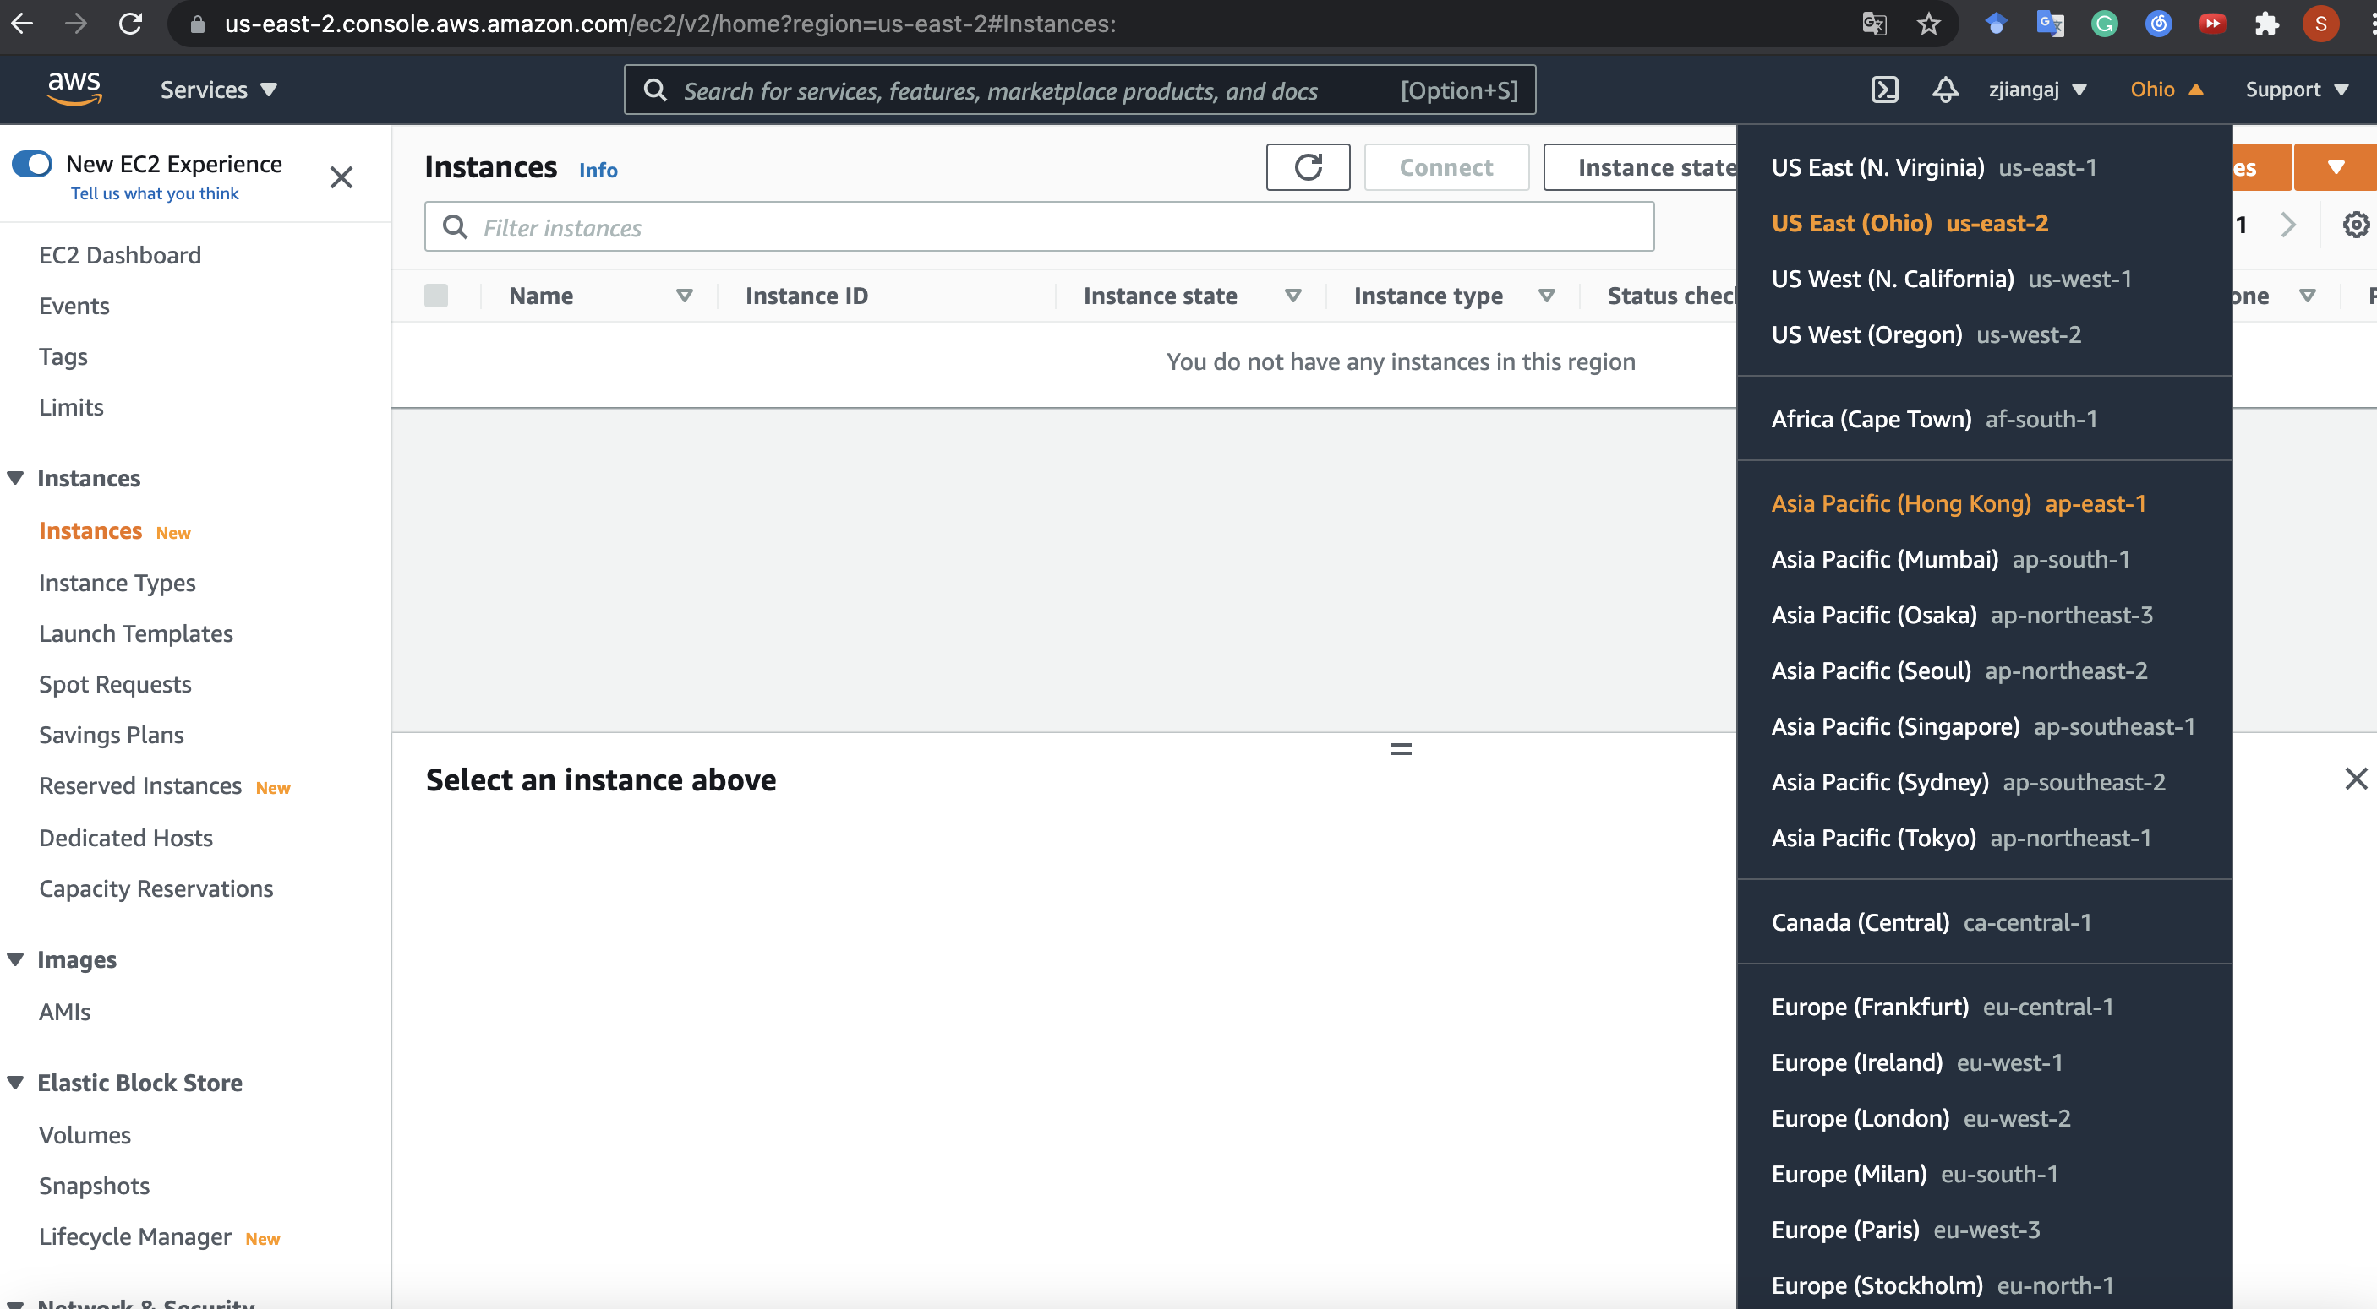
Switch to another EC2 Region
AWS provides EC2 instance located from different regions across the world
You can switch to a region that best suits you
(e.g., using us-east-1 if you are using a Classroom Account)

Slide 28
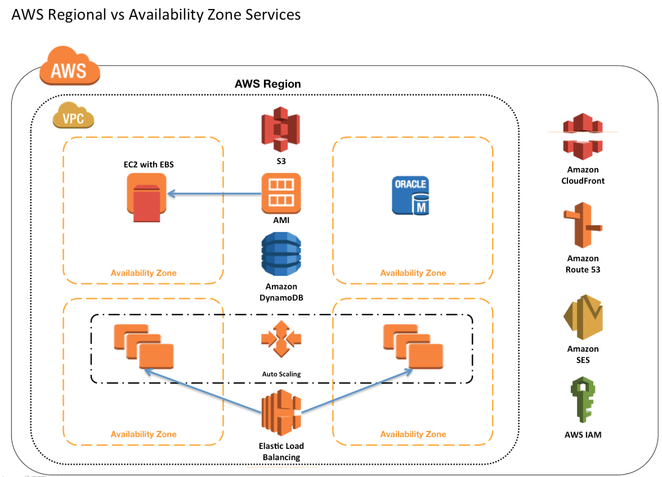
Pro Tip: Try to launch all your instances in the same availability zone, or inter-zone communication will cost you $$$$.

Slide 29
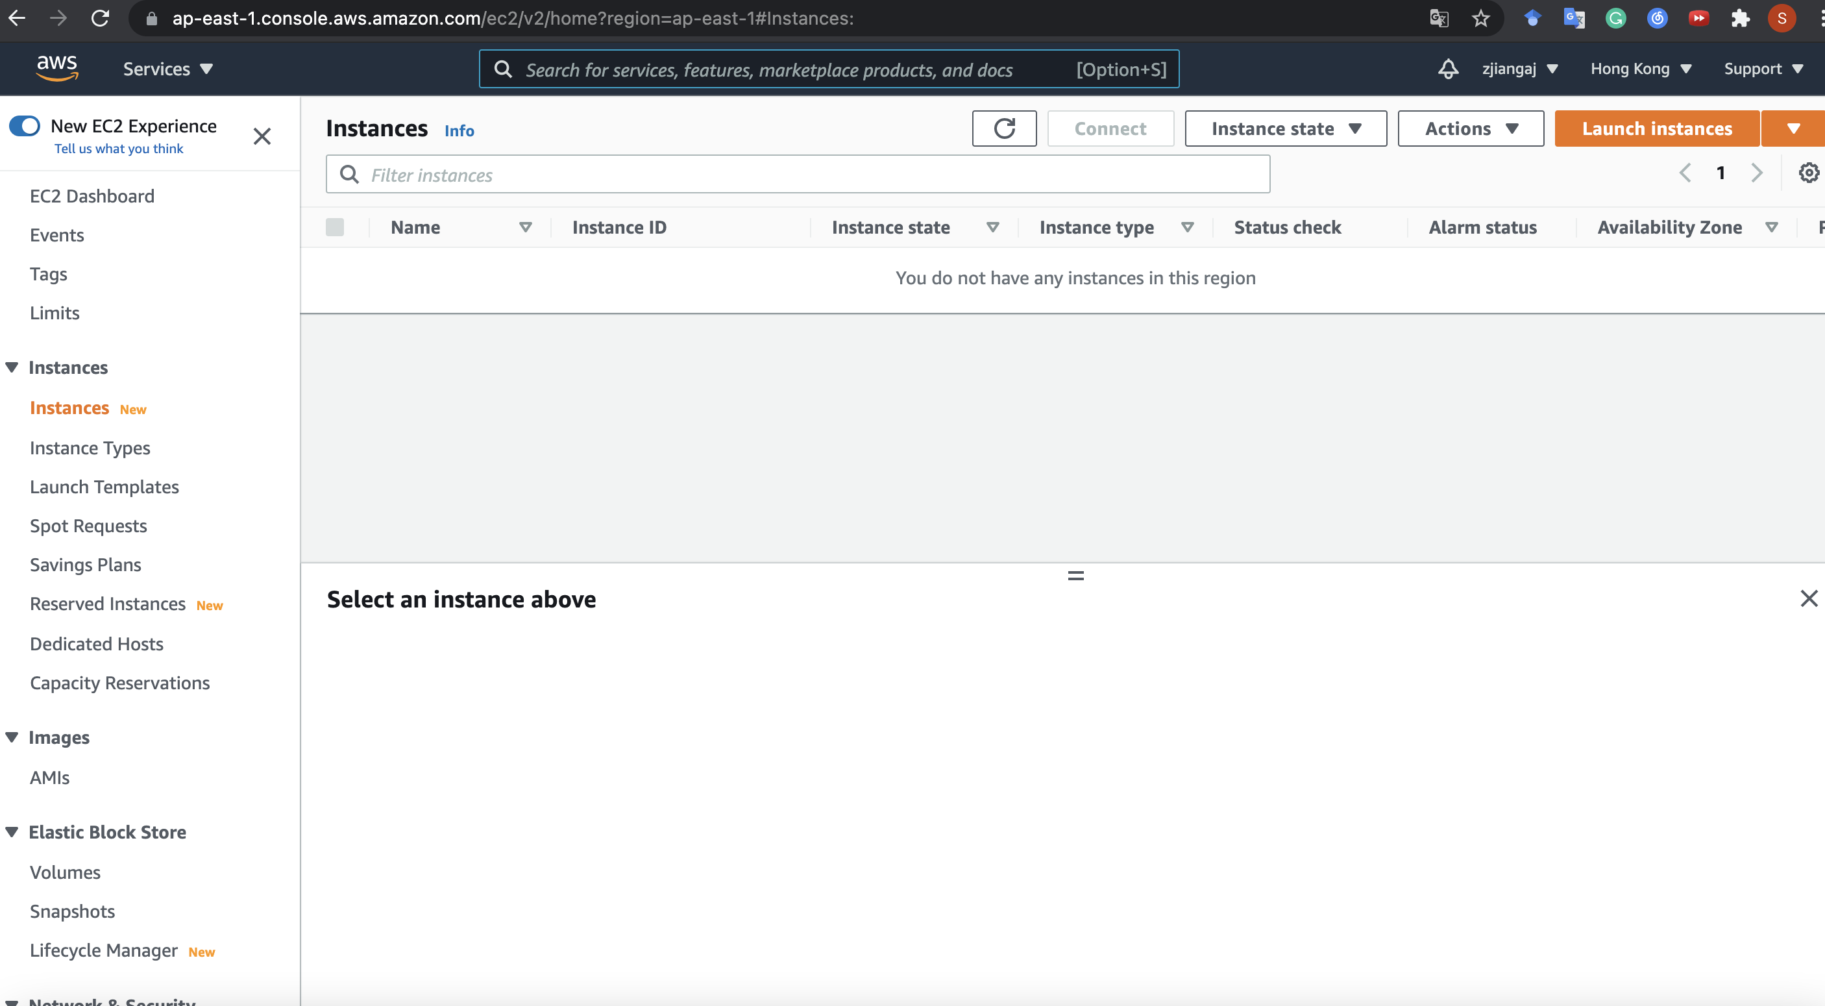
Switch to another EC2 Region
On success

Slide 30
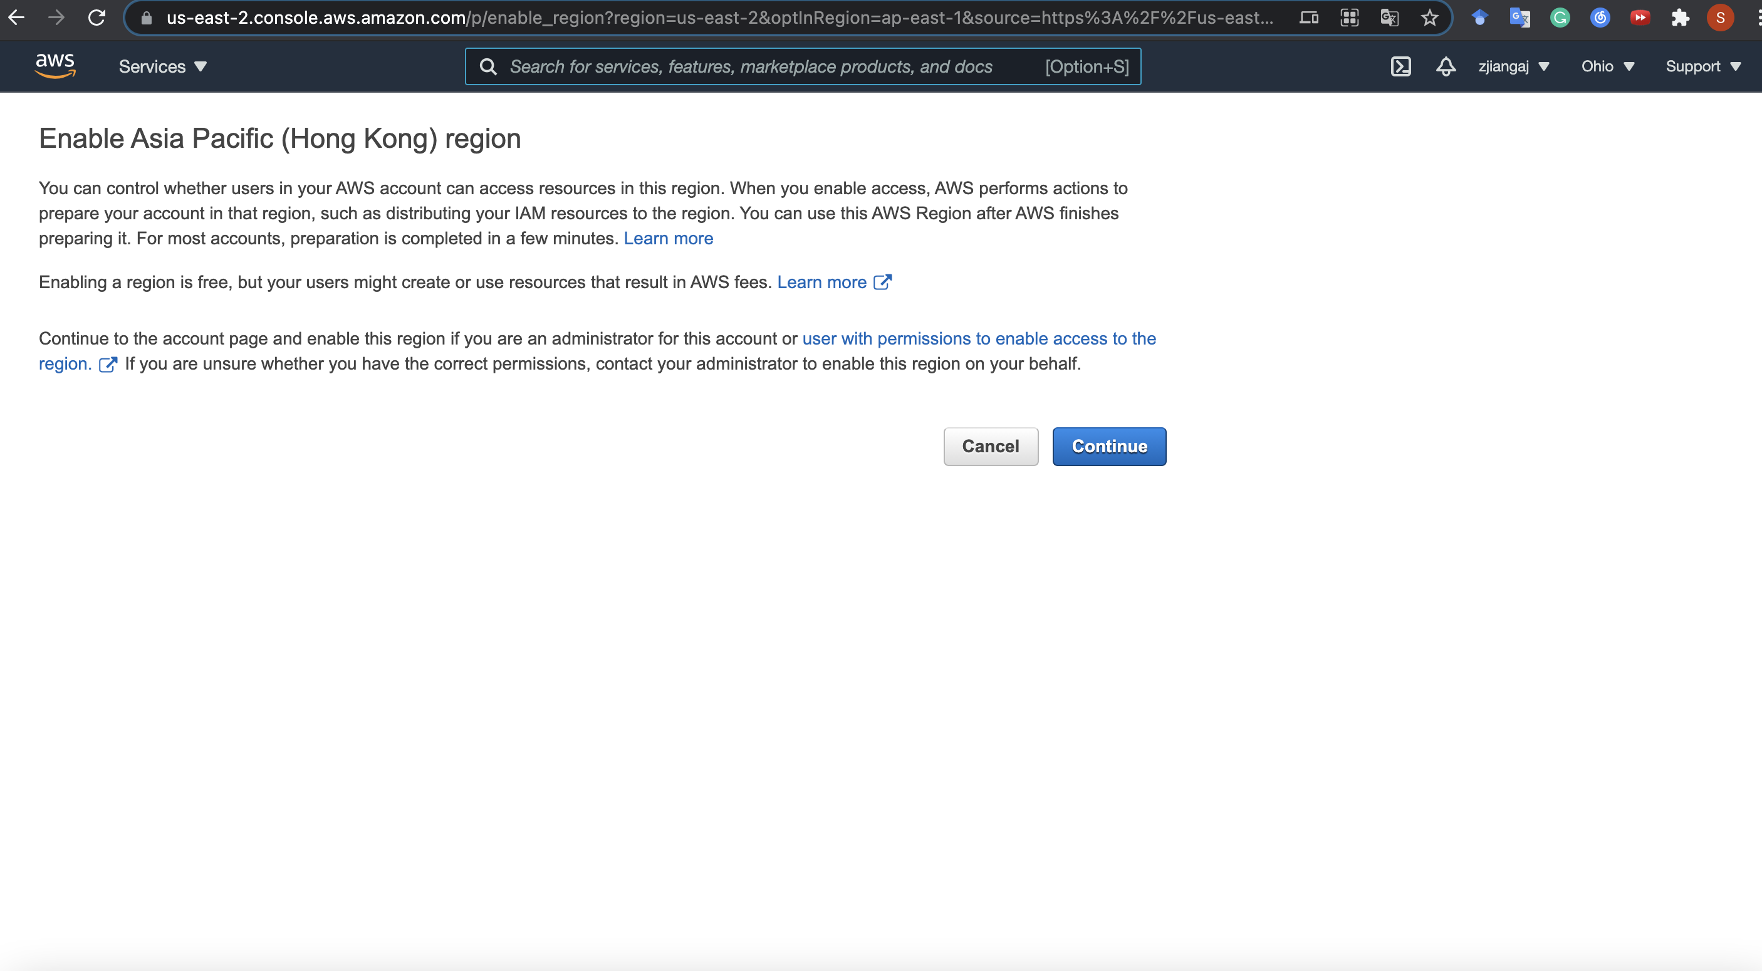
Enable an EC2 Region
If your selected region is not enabled by default, e.g., Asia Pacific (Hong Kong)
Just continue

Slide 31
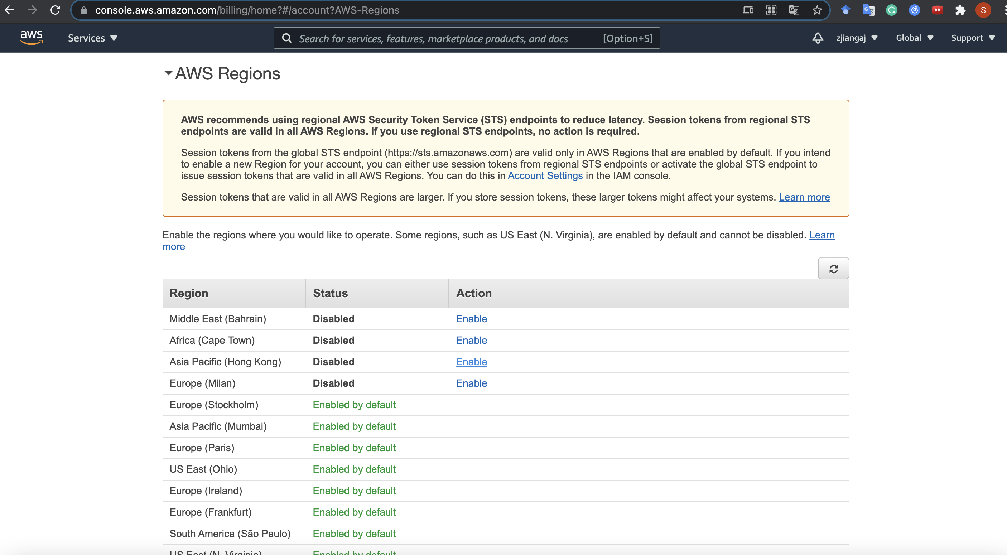
Enable an EC2 Region
Scroll down and click Enable if your selected region is not enabled

Slide 32
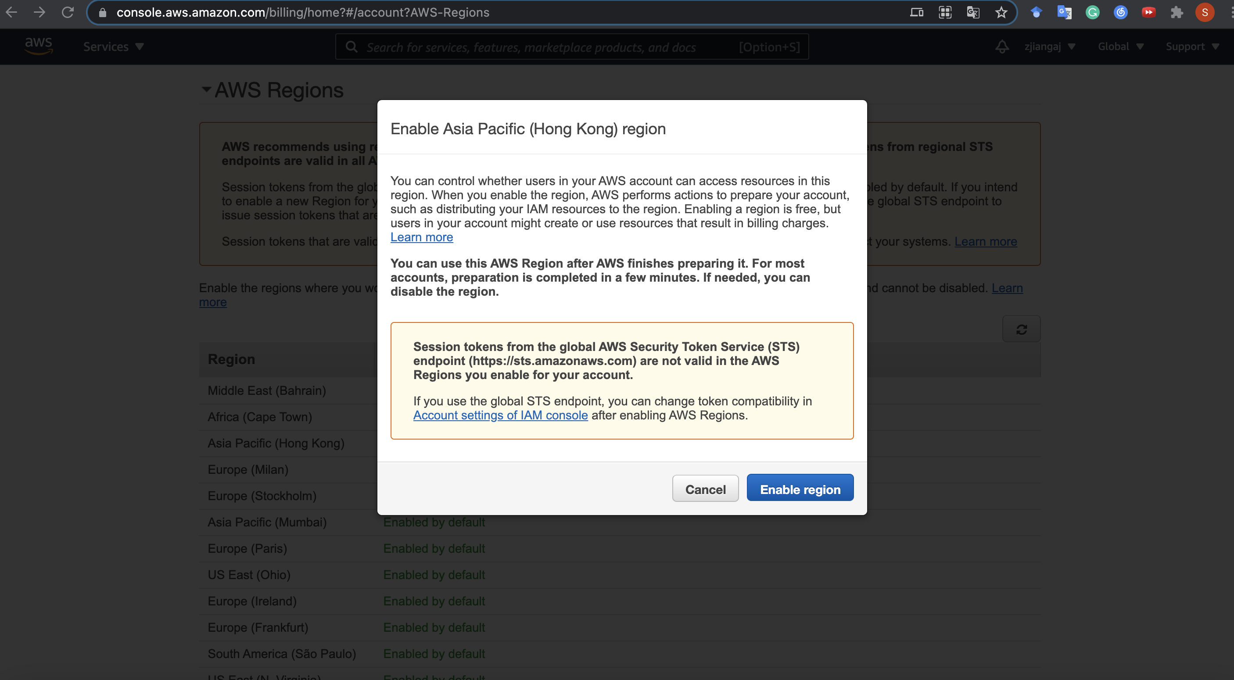
Enable an EC2 Region
Click!

Slide 33
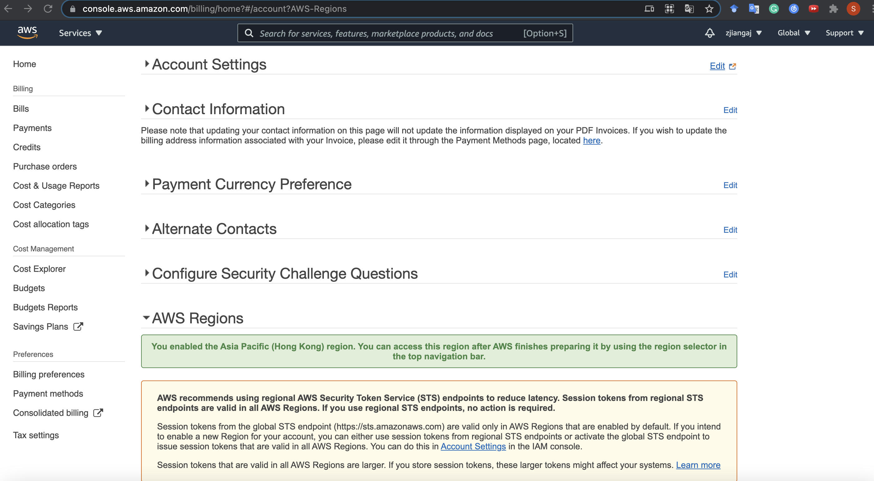
Enable an EC2 Region
On success you can see
Then return to your EC2 Console (https://console.aws.amazon.com/ec2/v2/home) and try region switch again~

Slide 34






SSH Authentication Process
Private Key
Public Key
User
Server
ssh -i <private_key> user@server
Matching
Session Key
Encrypted Communication

Slide 35
Key pairs
Amazon EC2 uses public–key cryptography to encrypt and decrypt login information.
A public key is used to encrypt data, such as a password, then the recipient uses the private key to decrypt the data.
The public and private keys are known as a key pair.
Notes:
SSH requires key pair.
A brief introduction of public-key cryptography.

Slide 36
Create key pairs
To log in to your instance, you must create a key pair, specify the name of the key pair when you launch the instance, and provide the private key when you connect to the instance.
For how to create a key pair, please refer to https://docs.aws.amazon.com/AWSEC2/latest/UserGuide/ec2-key-pairs.html#having-ec2-create-your-key-pair
Or follow the next few slides!

Slide 37
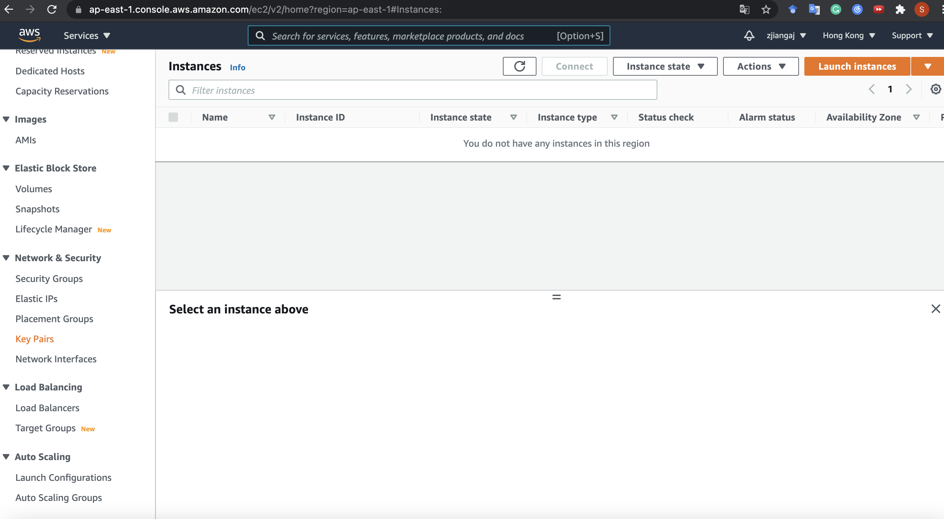
Create a Key Pair
Click here to manage your key pairs …

Slide 38
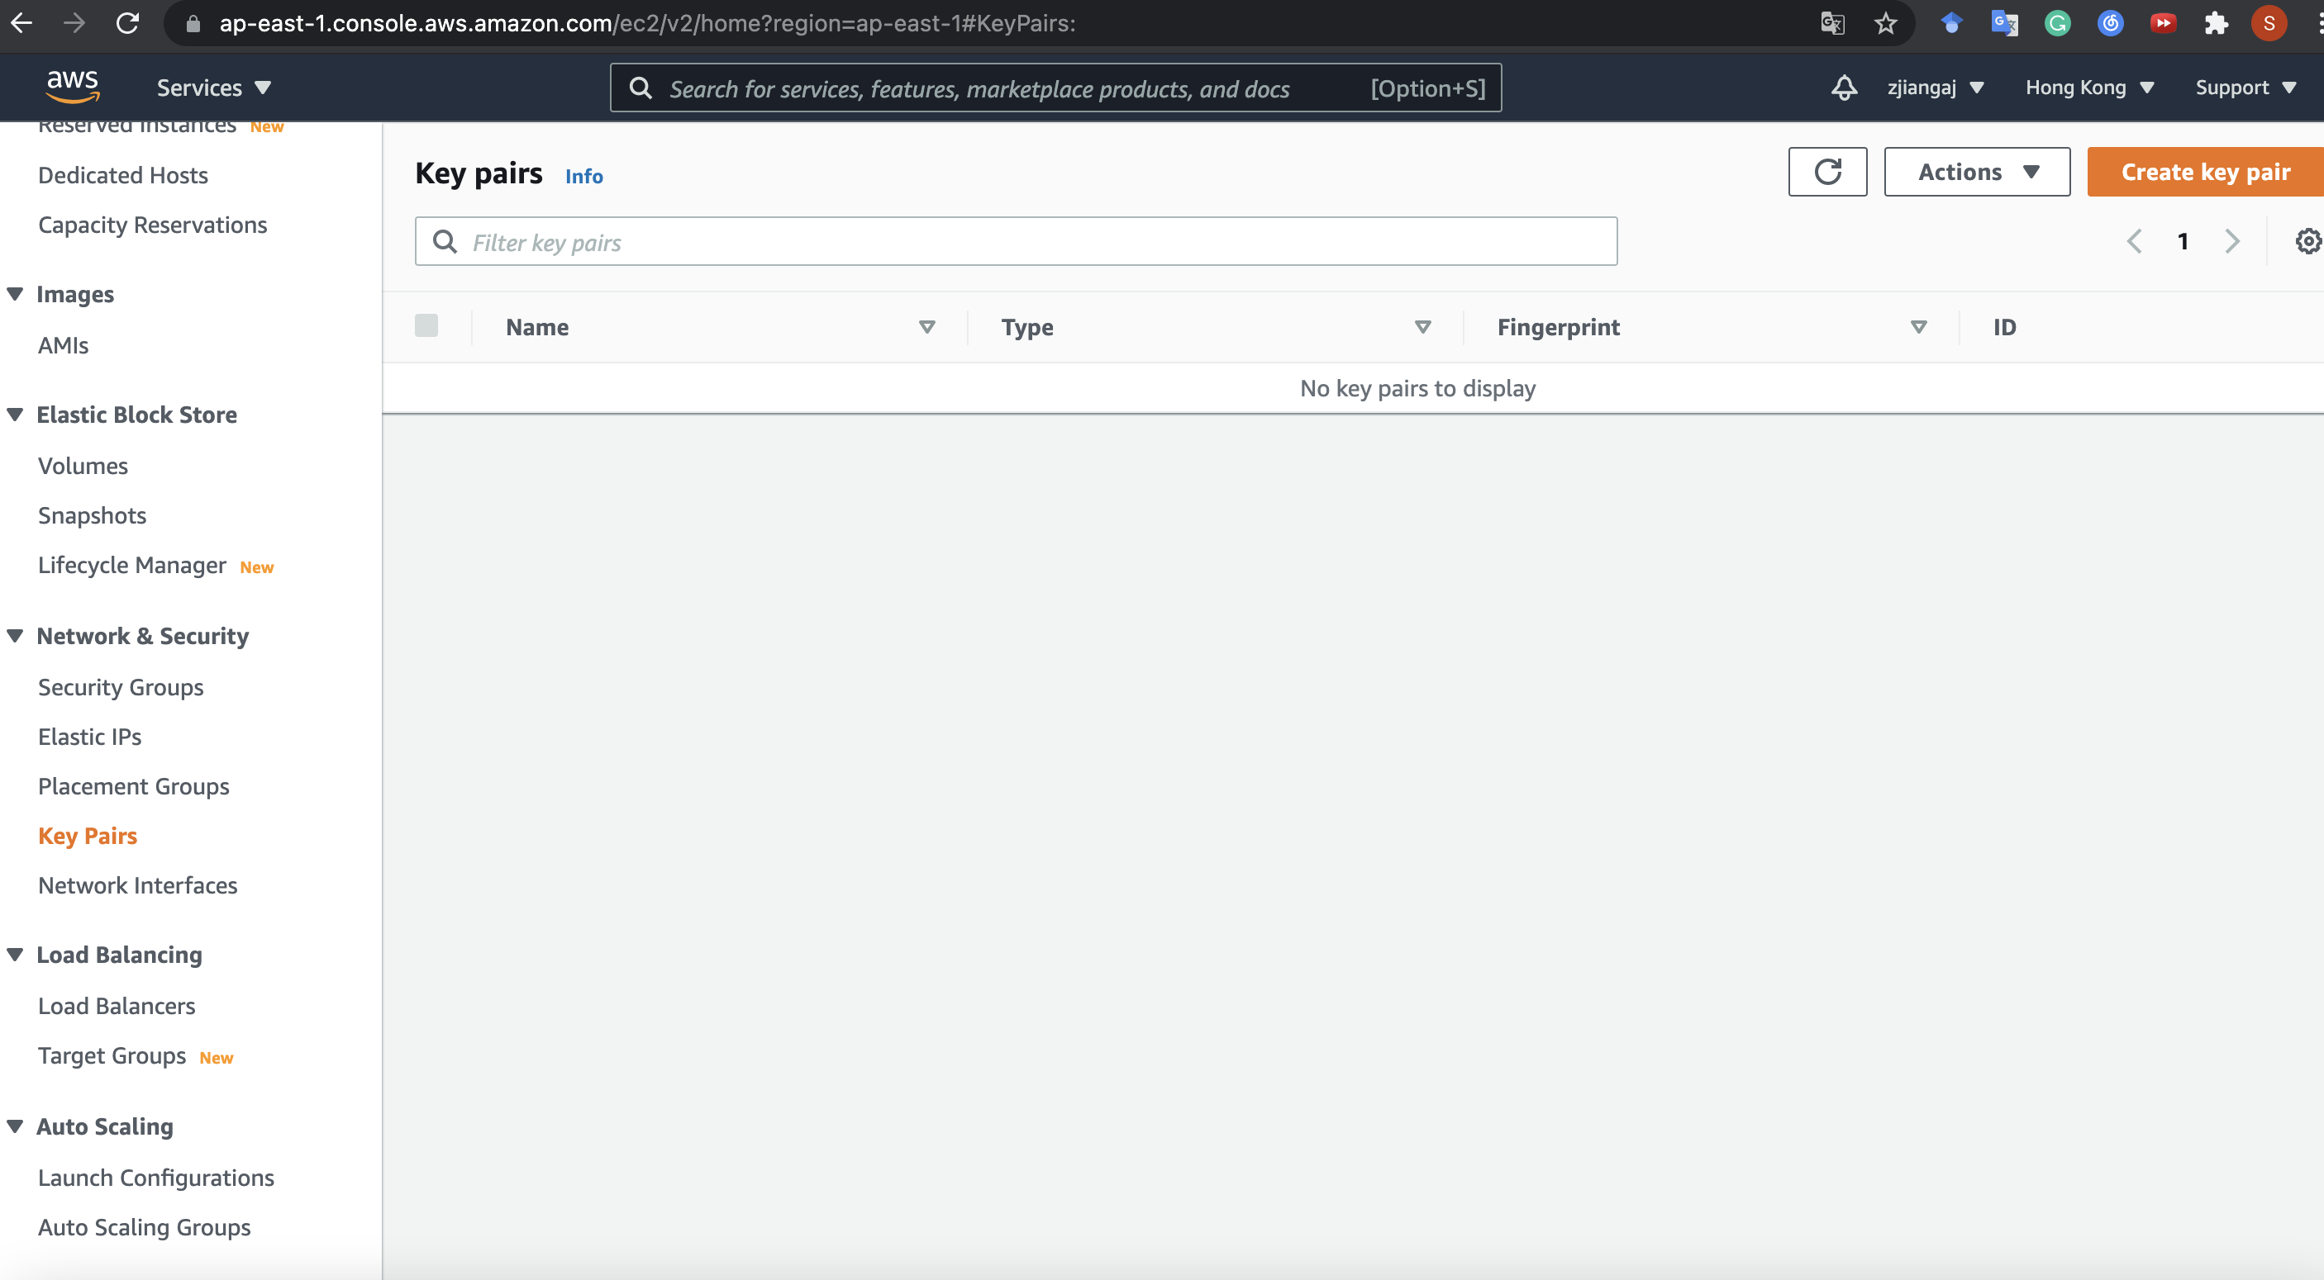
Create a Key Pair
Create a new one

Slide 39
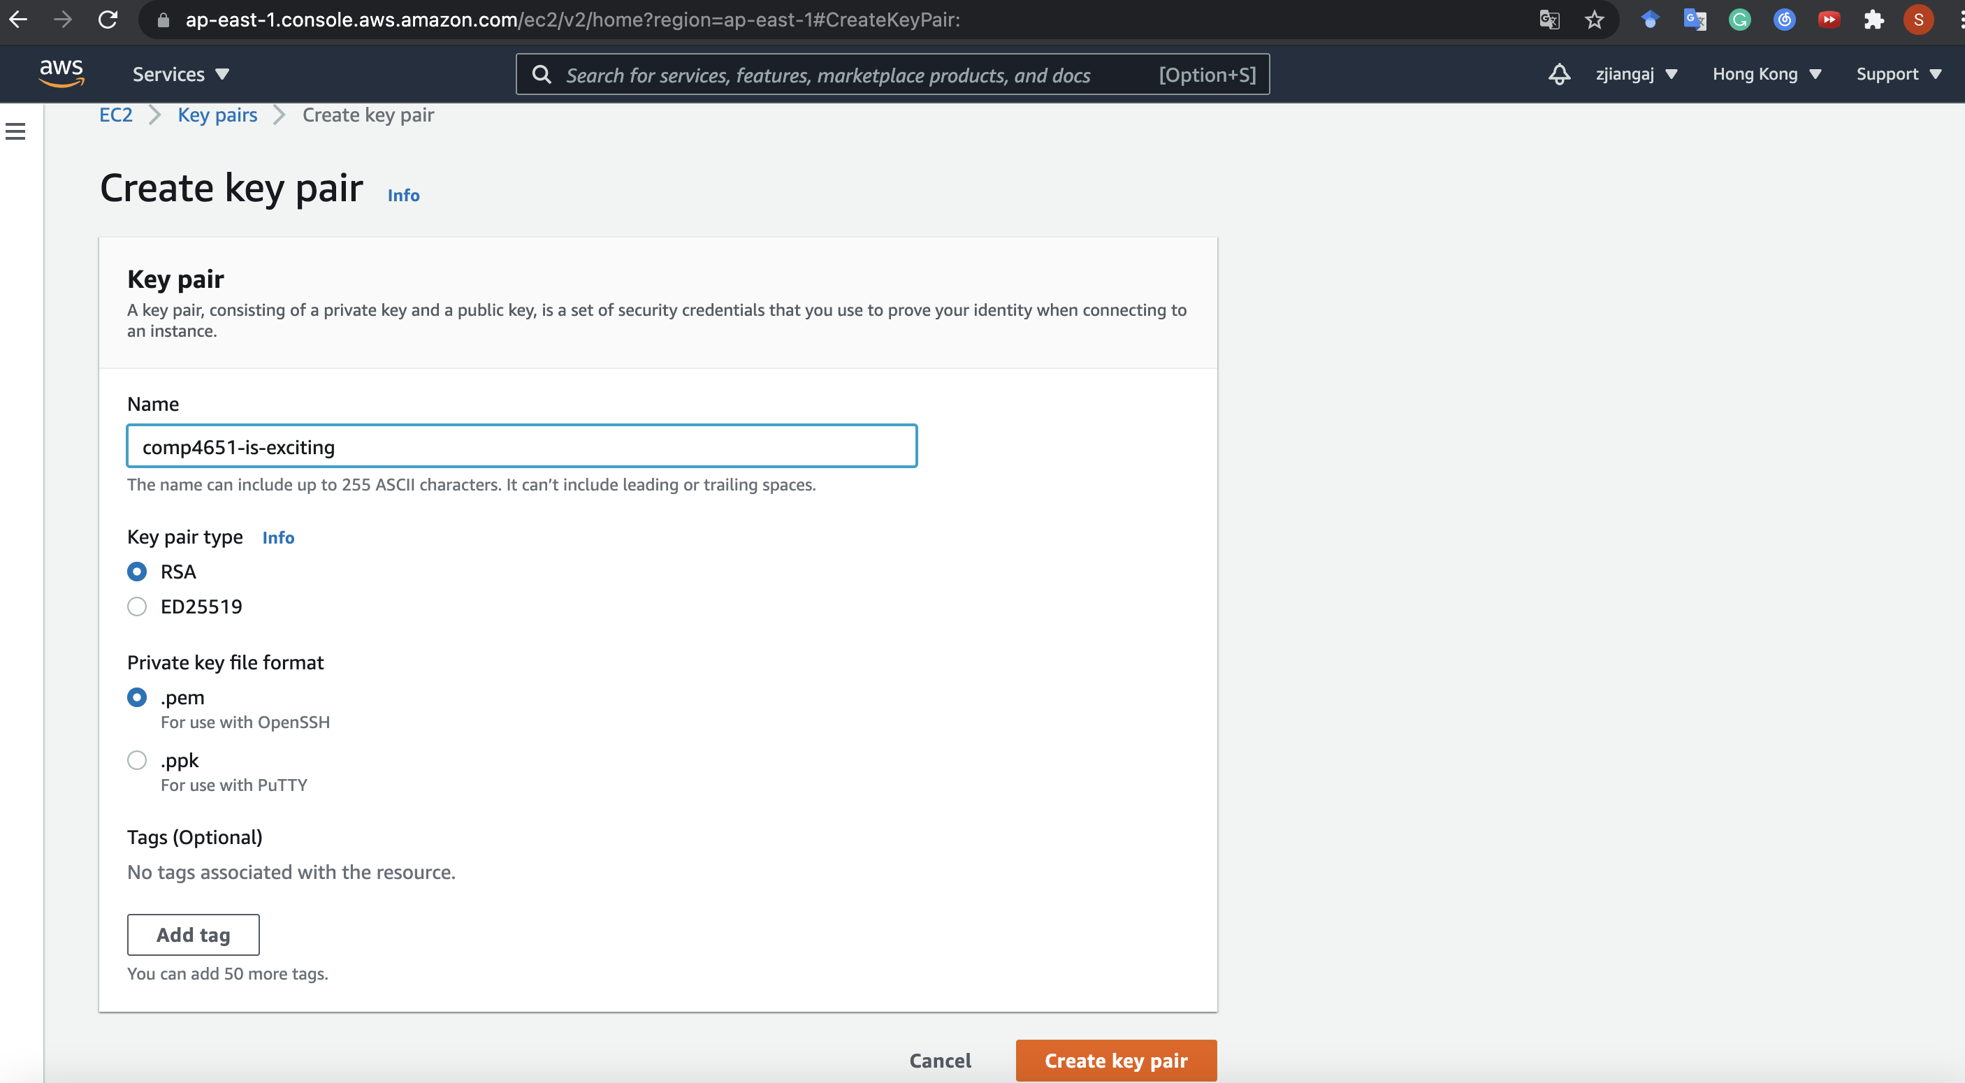
Create a Key Pair
Think of a name
Let other fields set by default... then create!

Slide 40
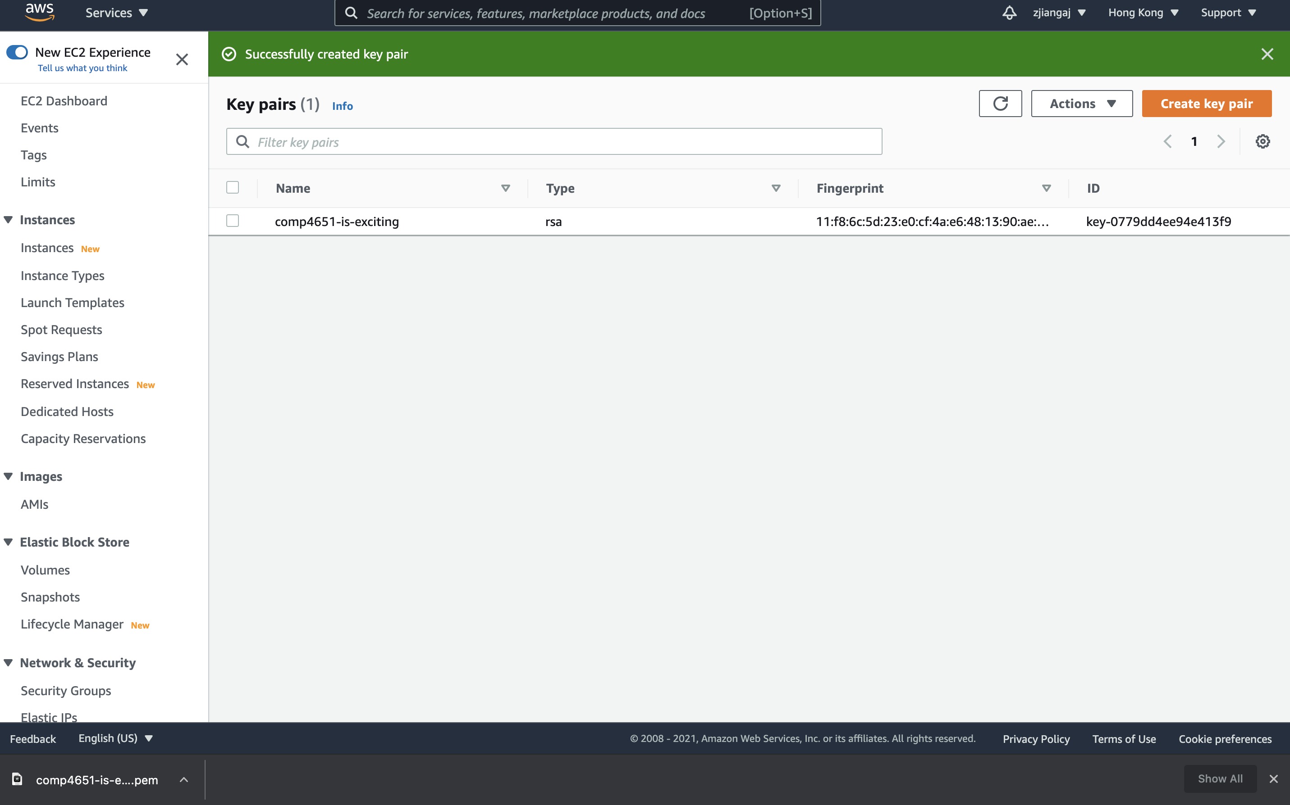
Create a Key Pair
On success, you see a banner
And a file is automatically downloaded...
That is the private key that you can use to access
your EC2 instances thereafter, so keep it safely!

Slide 41
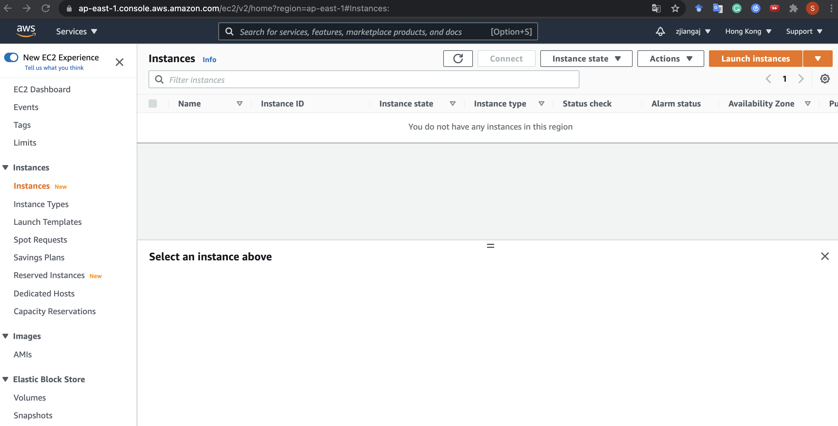
Launch an EC2 instance
With the key pair, we are ready to launch instances.

Slide 42
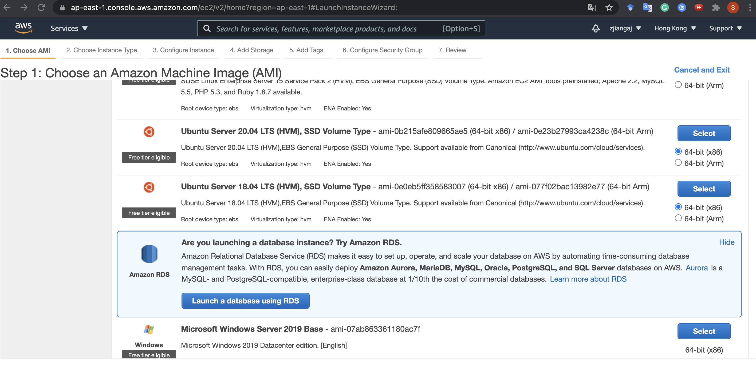
Launch an EC2 instance
Ubuntu is recommended (16.04, 18.04, 20.04)
For example, choose Ubuntu 20.04 and click Select

Slide 43
Server OS in EC2
Common server OS’es: Linux (RedHat, openSUSE, Debian, CentOS, Ubuntu, Amazon Linux) and Windows Server.
There are over 5000 OS images in EC2 to choose from. (2996 versions of ubuntu!)

Slide 44
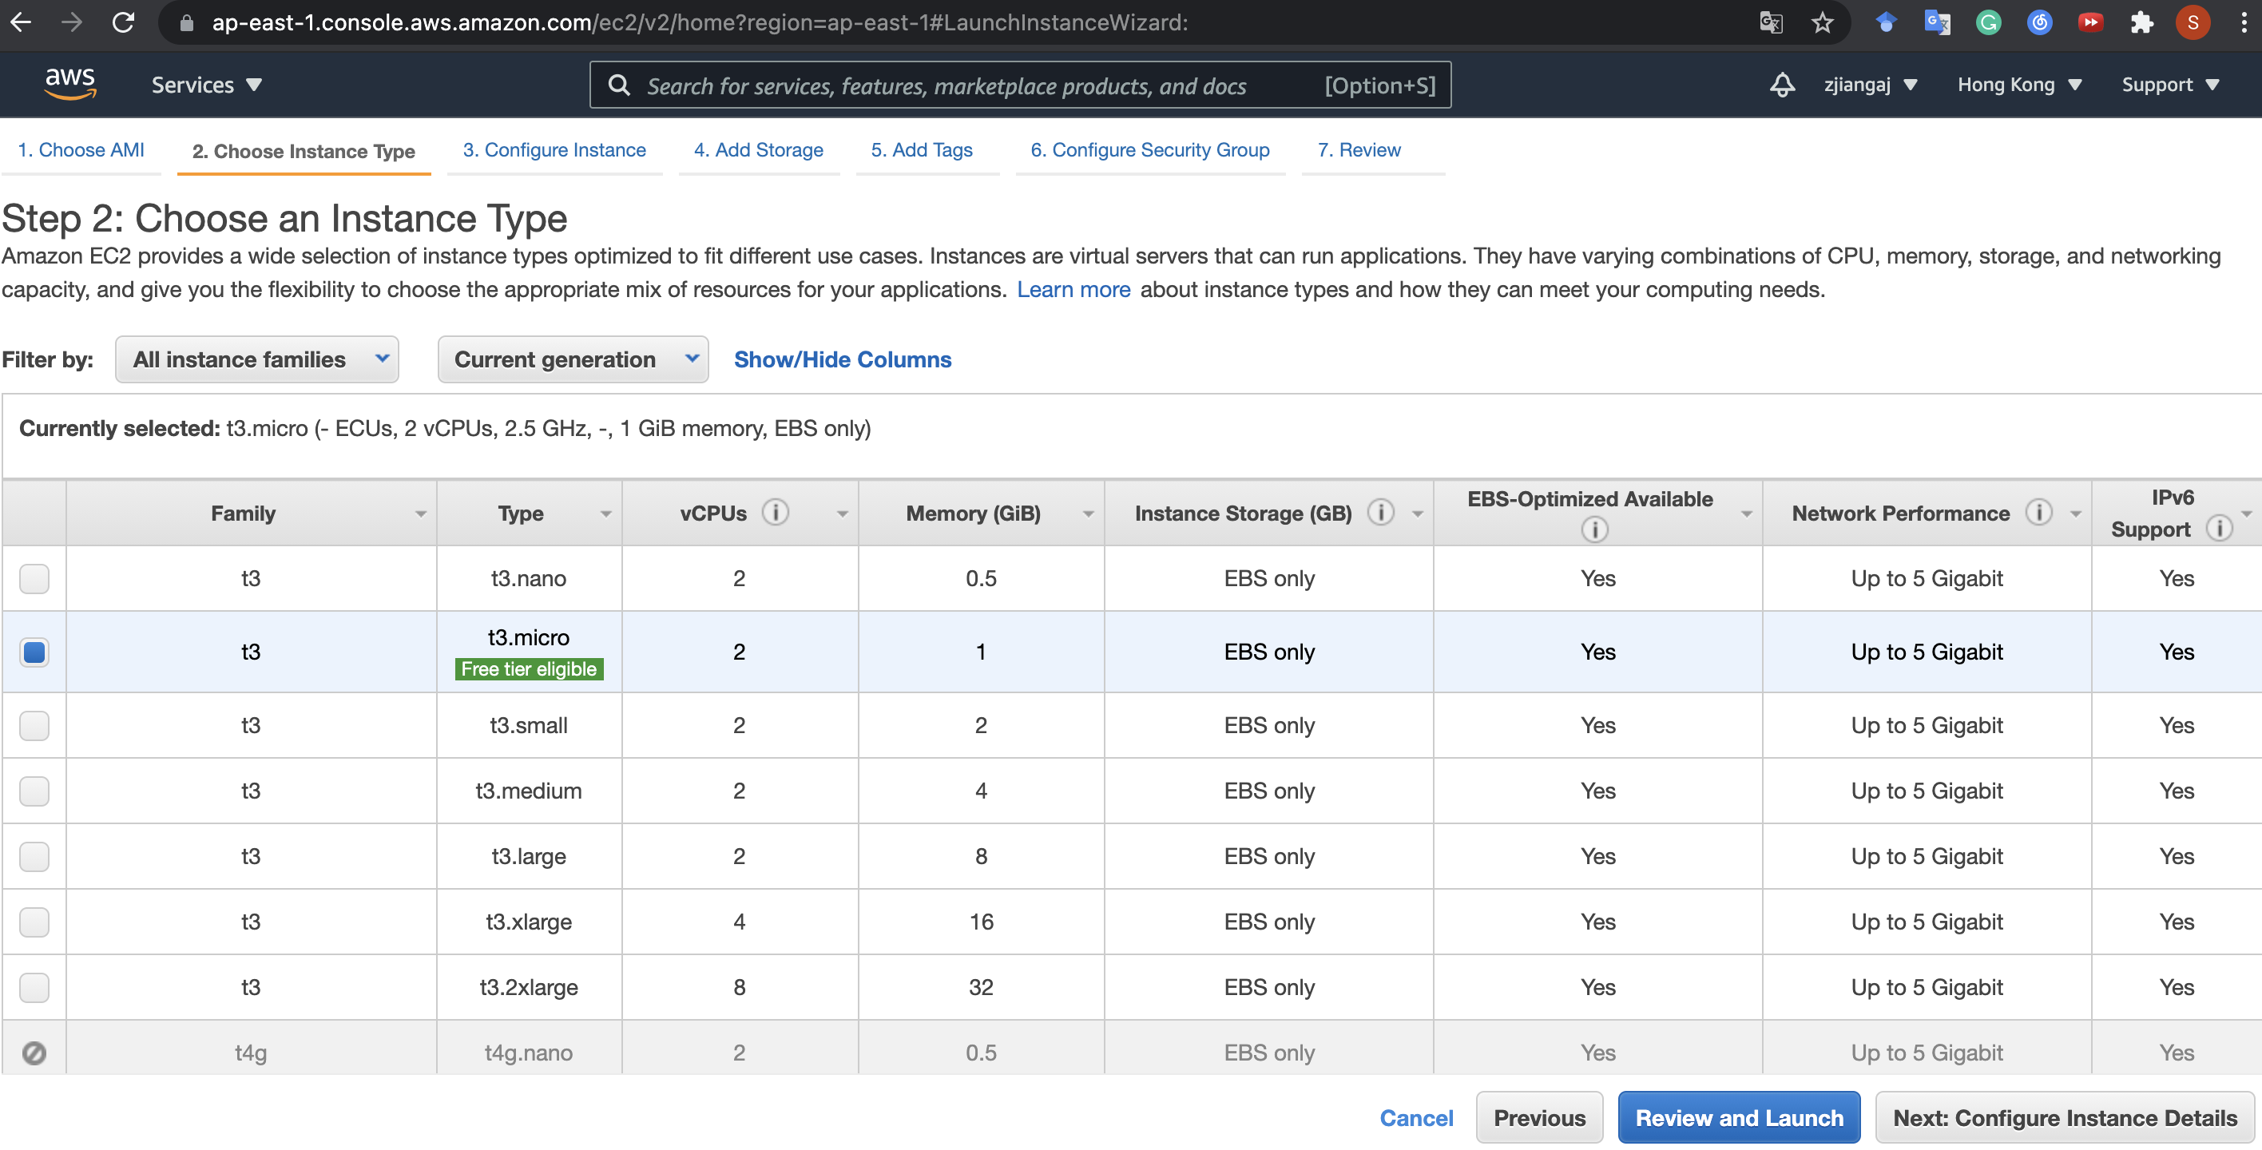
Launch an EC2 instance
For example, choose t3.micro
where t3: one class of General Purpose instances
micro: one tier of hardware specifications
Then Next!

Slide 45
EC2 instance types
General Purpose: a balance of compute, memory, and network resources
Memory optimized: lowest cost per GB of RAM
Storage optimized: better disk I/O and higher storage capacity
Compute optimized: lowest cost per vCPU
...
* For detailed information: https://aws.amazon.com/ec2/instance-types/

Slide 46
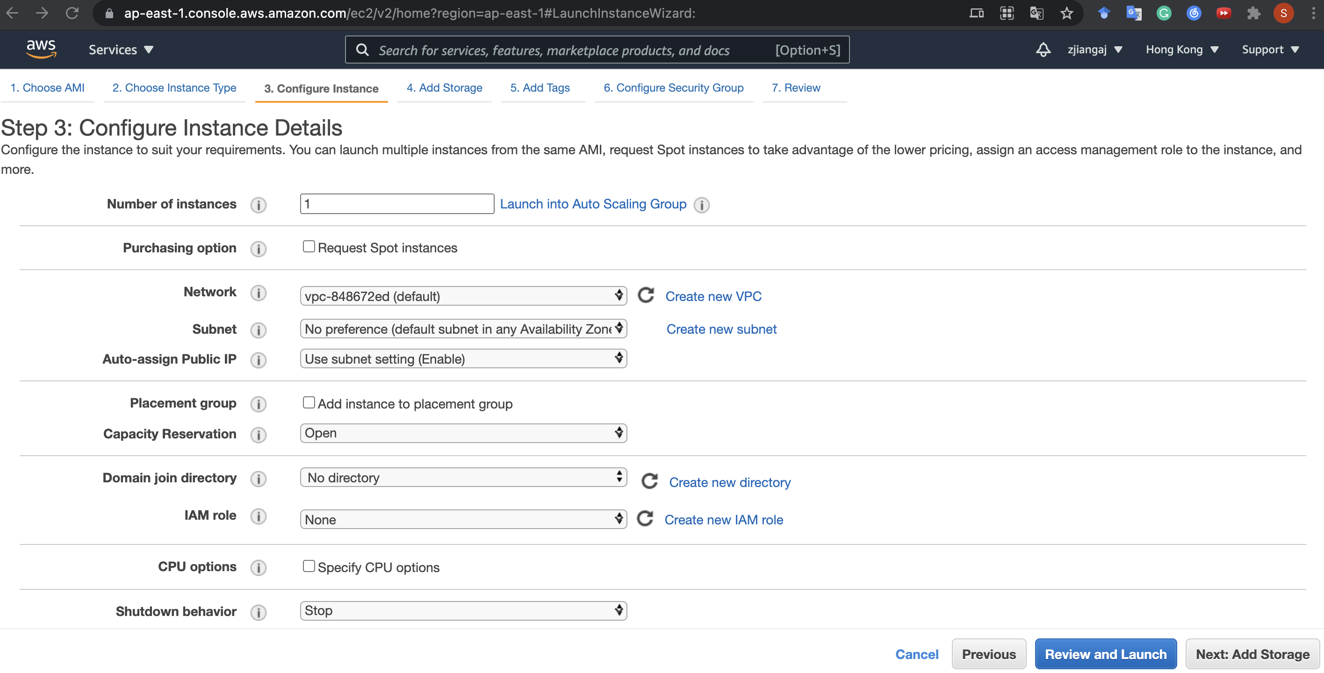
Launch an EC2 instance
Configure your instance if necessary, then Next

Slide 47
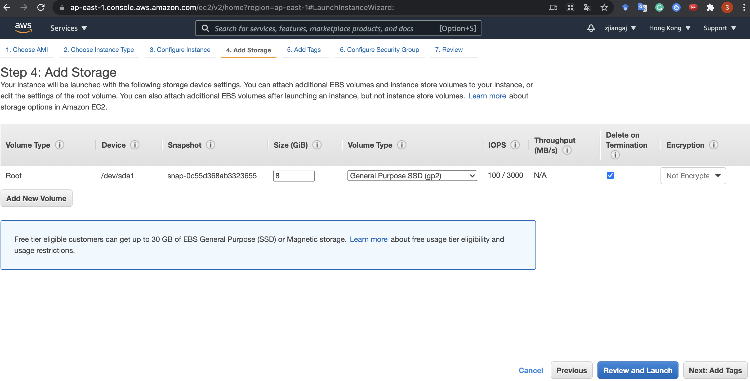
Launch an EC2 instance
Configure root volume, e.g., the disk size, if necessary, then Next

Slide 48
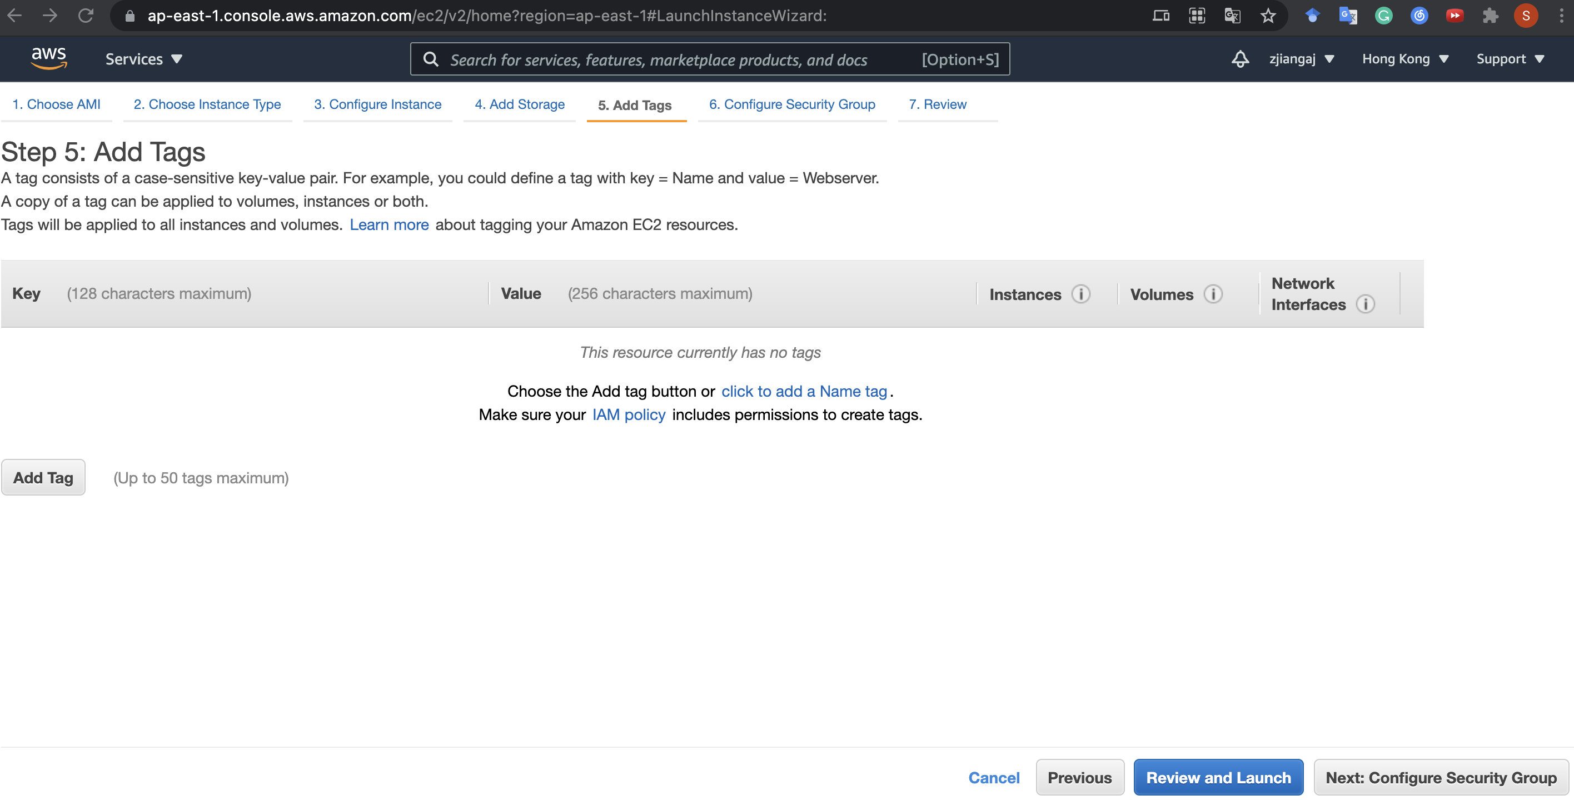
Launch an EC2 instance
Add tags if necessary, then Next

Slide 49
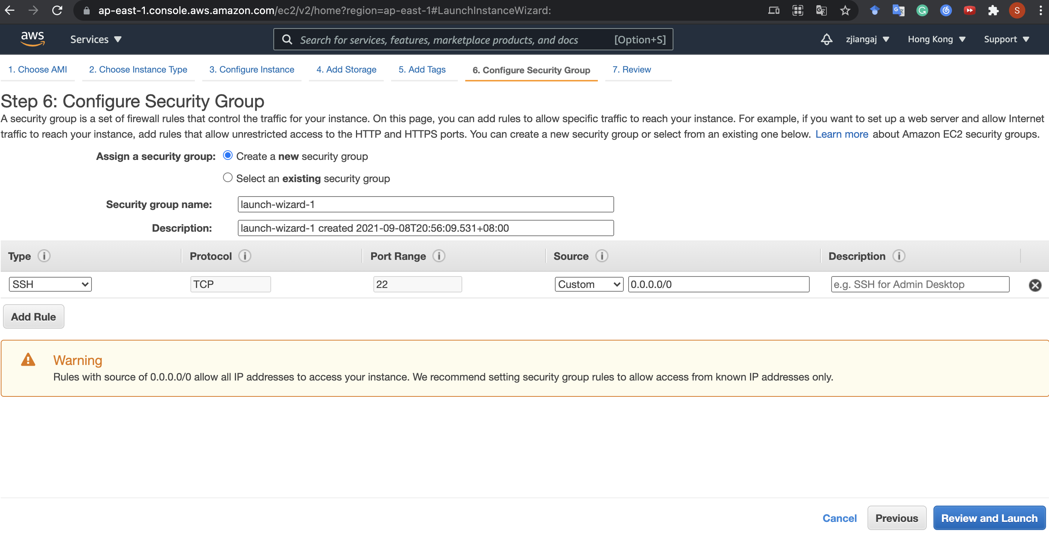
Launch an EC2 instance
Add/Edit/Delete security rules if necessary, then Review and Launch
Caution! The default security group only enables port 22 for SSH programs from any source IPv4 address (0.0.0.0/0) to access your instance. You may want to allow programs from other IP address and ports to access to your instance.
Notes:
What are security groups used for?

Slide 50
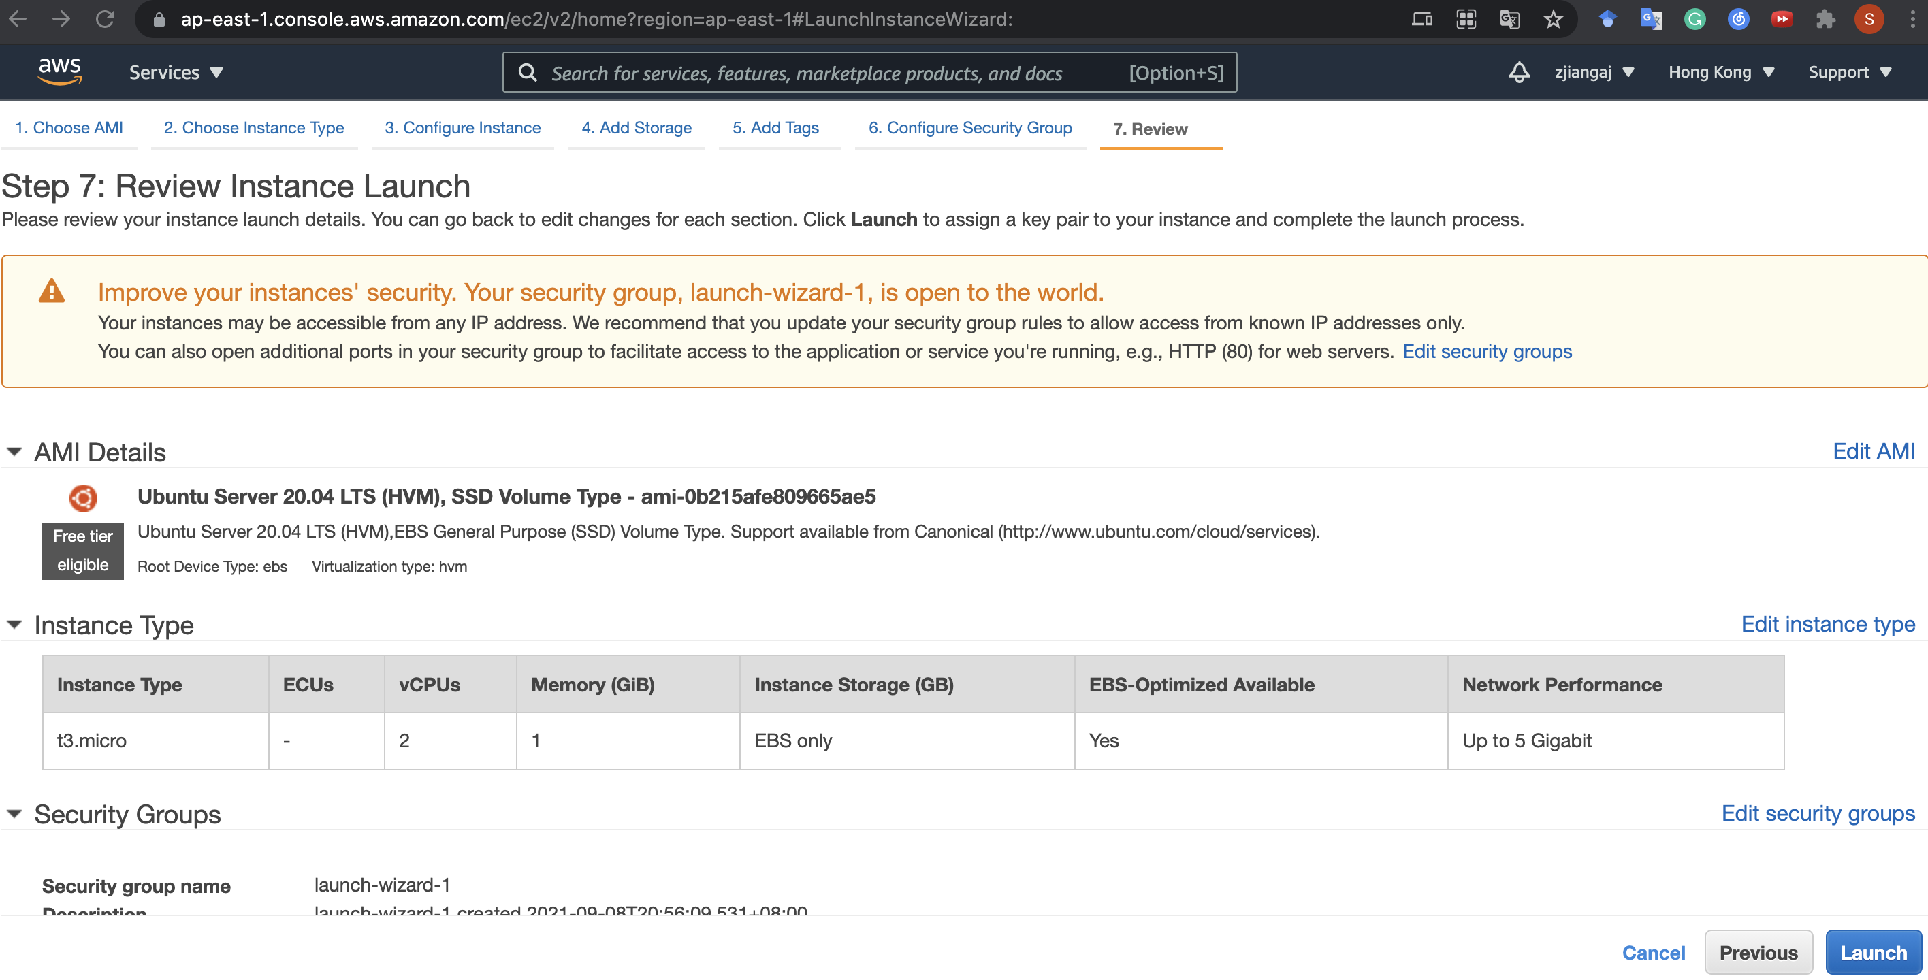
Launch an EC2 instance
Review and launch if no problem

Slide 51
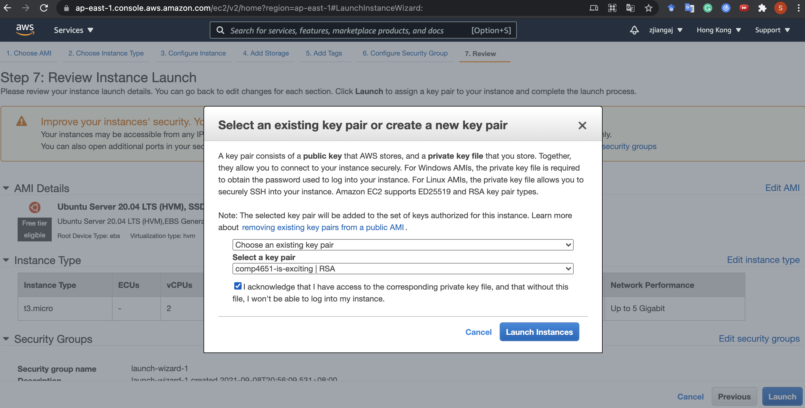
Launch an EC2 instance
Choose the key pair you have just created
and check the box “I acknowledge...”

Slide 52
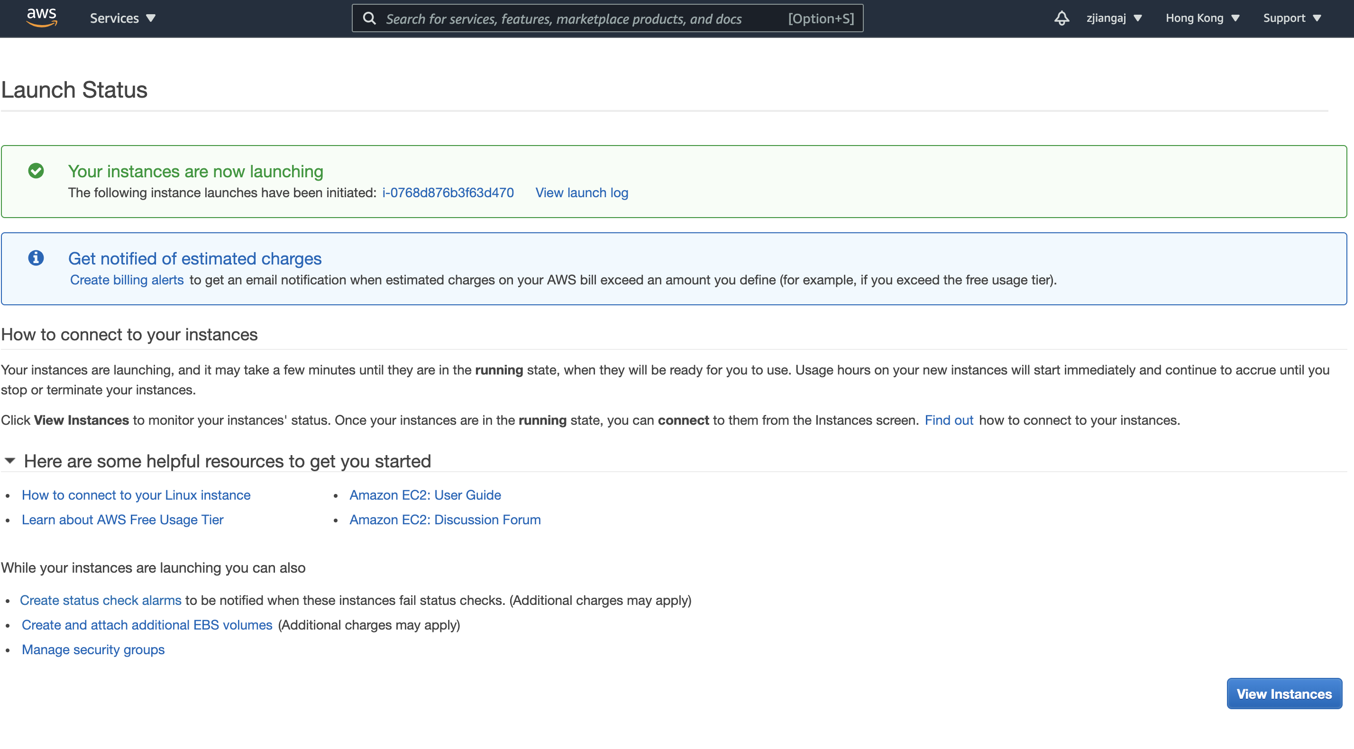
Launch an EC2 instance
On success, the instance will be automatically started, view it!

Slide 53
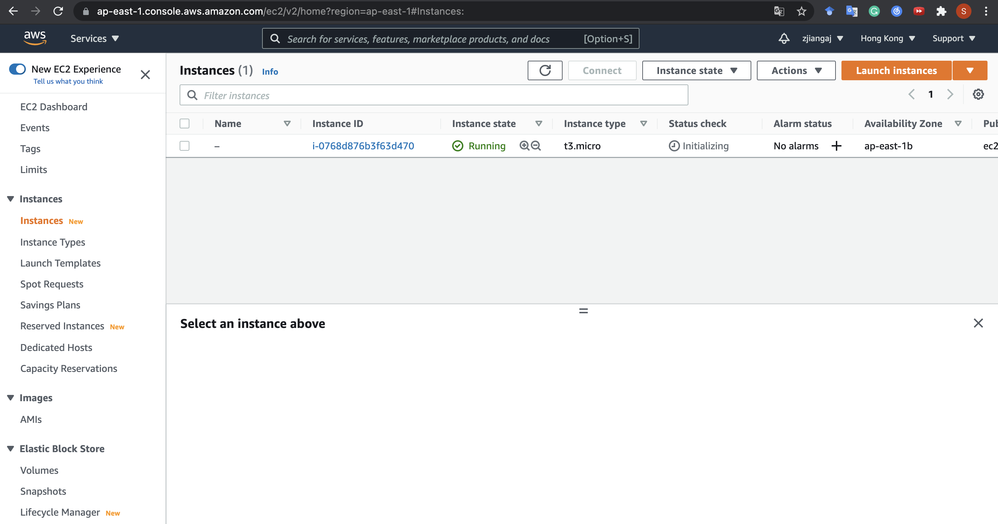
Launch an EC2 instance
Well done! You can now see it running!

Slide 54
Outline
Create an AWS Account
Launch an EC2 Instance
Connect to an Instance
Stop an EC2 Instance

Slide 55
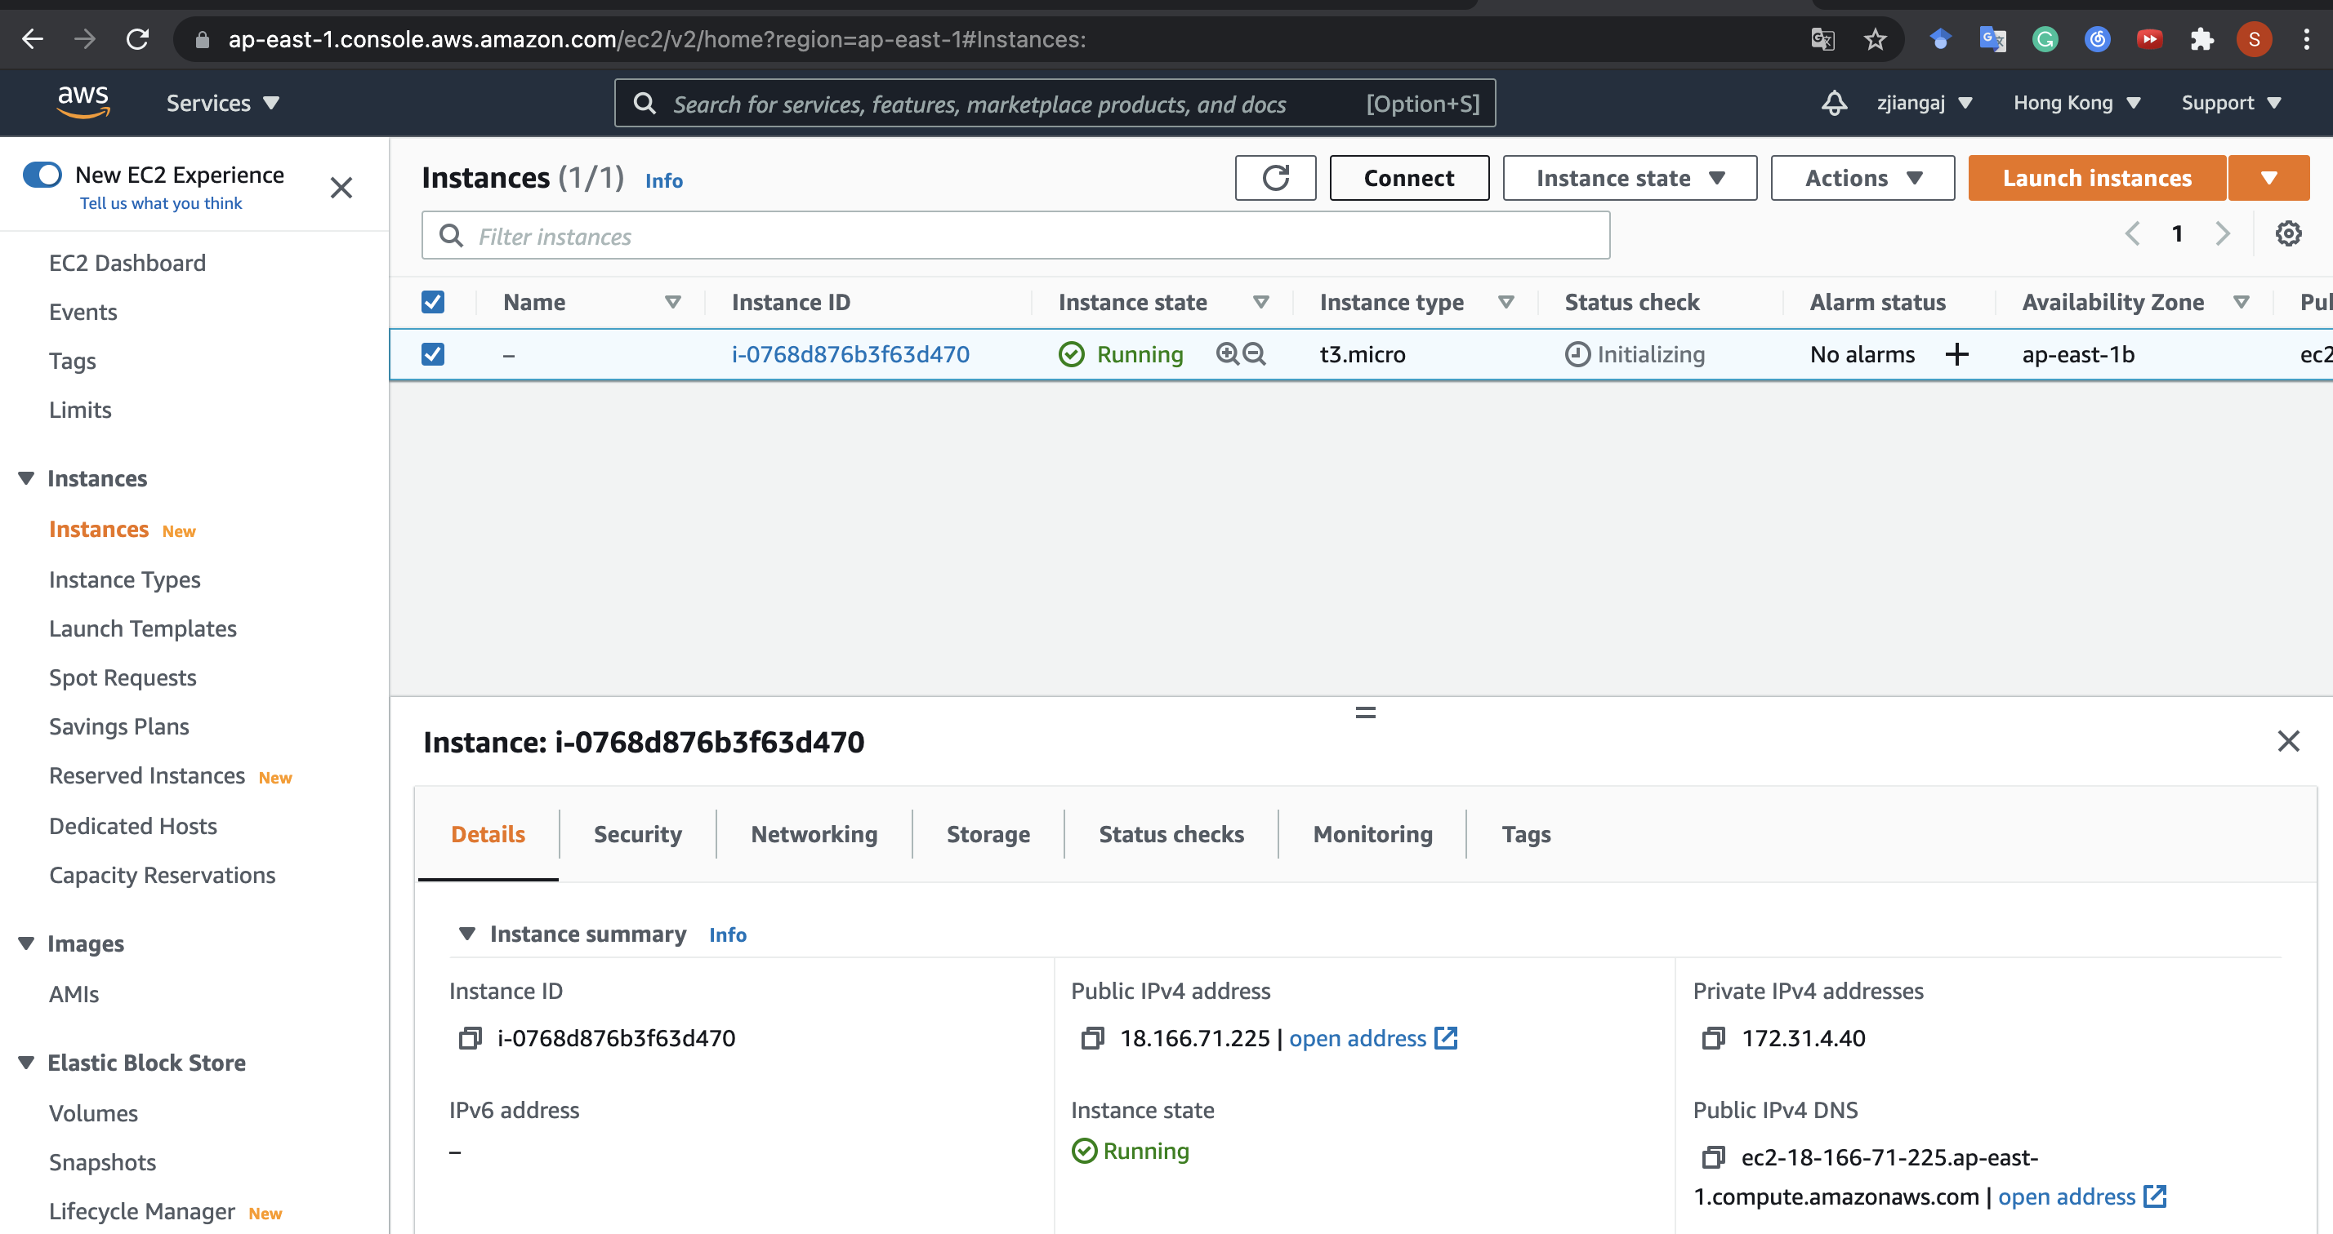
Connect to an EC2 instance
2. Click here and follow the instructions prompted
1. First select the target instance

Slide 56
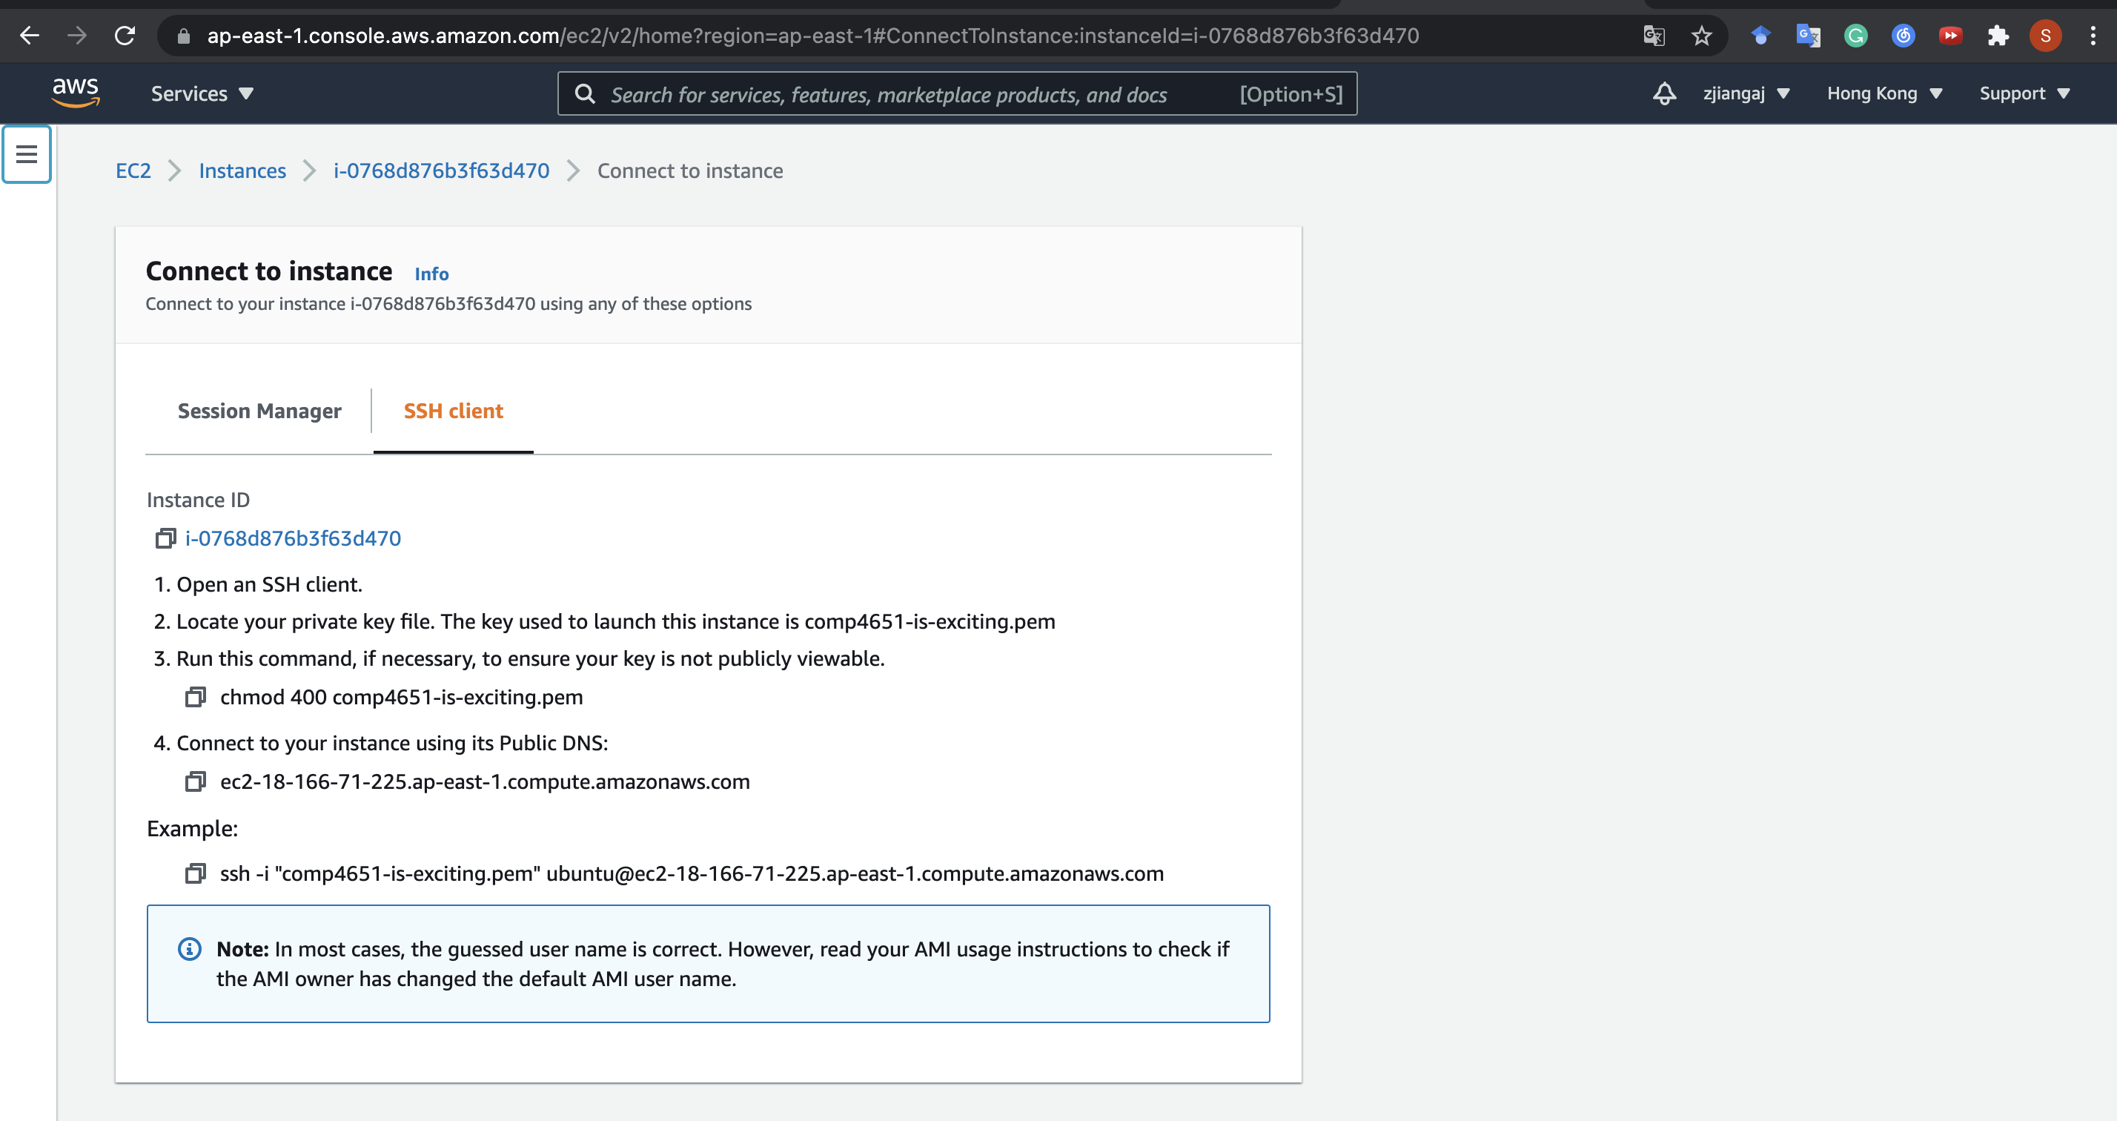
Connect to an EC2 instance
Just follow~

Slide 57
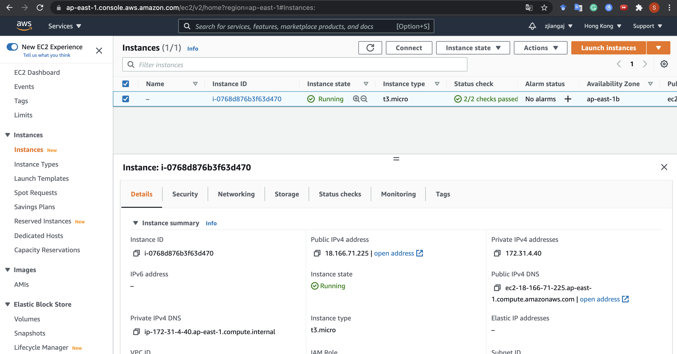
Public vs. Private IP
reachable within the same network
e.g., connecting from another instance in the same availability zone
(Never change)
reachable from the Internet
e.g., used in SSH from your laptop
(Change each time you start the instance!)

Slide 58
Connection Test
To test whether your instance is connected to the Internet, access google from your EC2 instance. Type the command in the SSH shell after successfully connecting to the instance. The command will download the homepage of Google to your current directory.
To test the connection from your computer to EC2 instance, upload a file from local computer to EC2 instance. Type the command in another terminal without SSH connection. The command copies <local_file> to the directory “~” of the remote instance.
scp -i <private_key_path> <local_file_path> ubuntu@<public_ip>:~

Slide 59
Outline
Create an AWS Account
Launch an EC2 Instance
Connect to an Instance
Stop an EC2 Instance

Slide 60

Stop an EC2 instance
Find the running instance

Slide 61
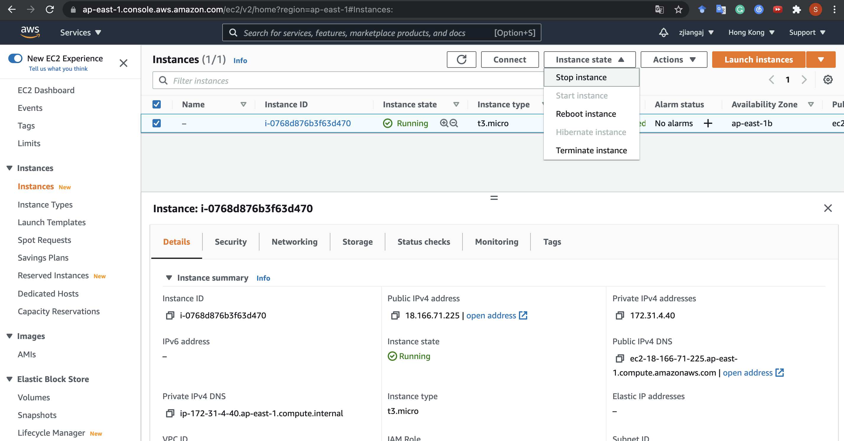
Stop an EC2 instance
Select Stop
(Not Terminate!)
Stop: I won’t use it now, but I want to start it later (so your programs and data remain)
Terminate: I will never use it again, and thus I would like to forget about it forever

Slide 62
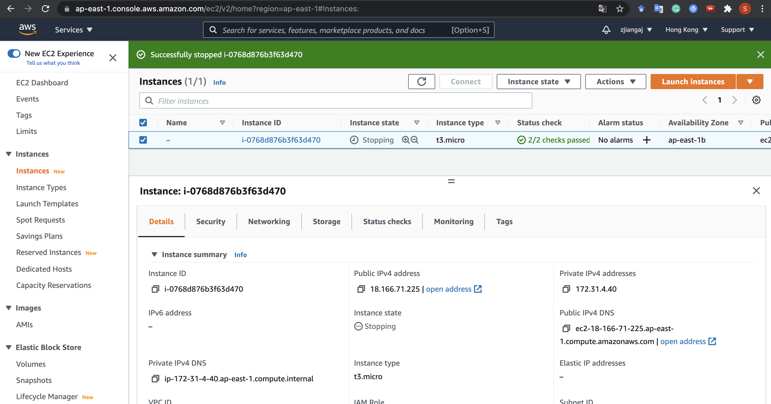
Stop an EC2 instance
On success you will see this

Slide 63
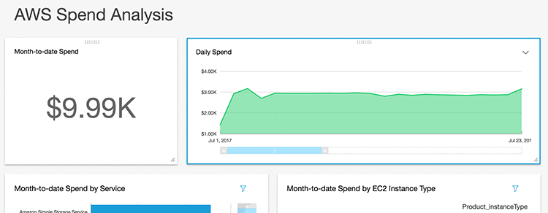
Stop an EC2 instance
Remember to stop the instance!!!
Otherwise, do expect bill like this:

